Slide 1
Title Screen

Slide 2
Schedule of Upcoming Sessions
1 – How to Set Up a Basic Website
2– Setting up a Facebook Page
3 – Using Canva to Create Marketing and Social Media Graphics
4 – Creating Email Newsletters with Mailchimp
5 – Best Practices for Writing Great Social Media Posts (Today)
6 – Adapting Content to Save Time (7/19)
7 – Basics of Boosted Posts for Facebook to Reach New Audiences (8/16)
8 – Outreach: Event Promotion Tactics (9/13)
9 – Using Local Search and Google Search to be Found (10/11)

Slide 3
Learning Objectives
Learn how to write a compelling post and the purpose of calls to action
Review how to create shortened web links and how to tag other organizations
Discuss what makes a good story and learn the FEEL-THINK-DO content planning framework
Determine how to start to define your voice
Discuss how frequently should you post and when should you post
Hear thoughts from other FCNC Friends about the parts of worship that excite you and brings you back
Study the qualities that make images strong and how to get started with video content
Get guidance on when to use an event vs. link to event content on your website

Slide 4
Why Are We Focusing on Facebook?
Name of Social Media Network | Monthly Active Users (MAUs)
Facebook | 2.27 billion
YouTube (owned by Google) | 1.9 billion
Instagram (owned by Facebook) | 1 billion
Twitter | 321 million
LinkedIn (owned by Microsoft) | 303 million
Snapchat | 100 million
Sources: Facebook, YouTube press rooms, Washington Post, Sprout Social, AdAge Digiday

Slide 5
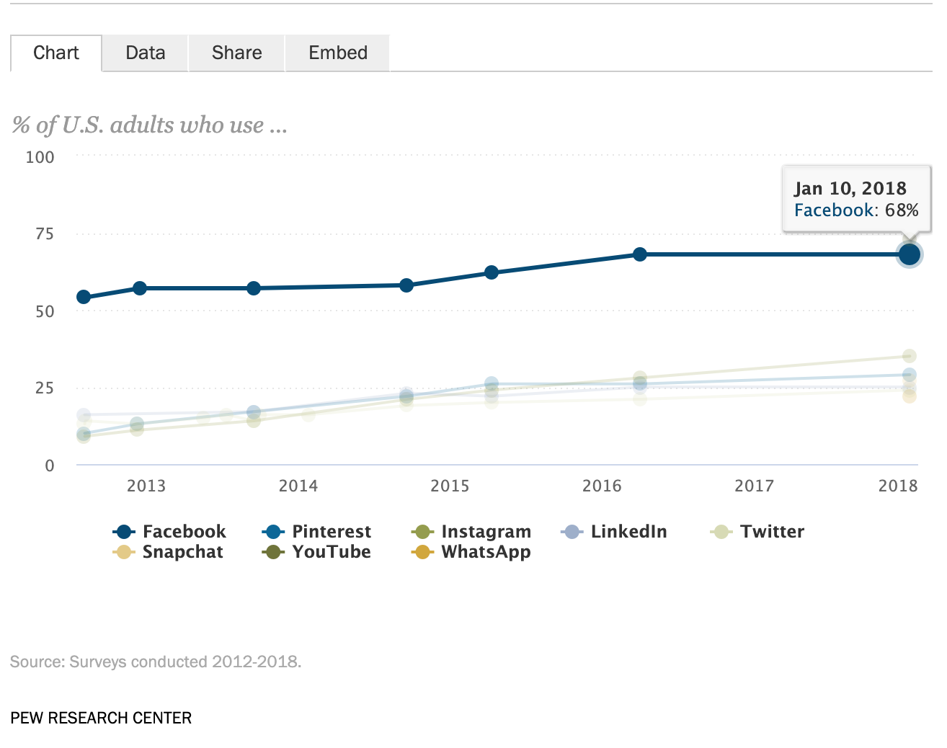
Why Are We Focusing on Facebook?

Slide 6
Anatomy of a Good Post

Slide 7
Creating Shortened Links
If you don’t do this your link can appear truncated (…)
Looks less professional
Easy to fix!
Easy to customize

Slide 8
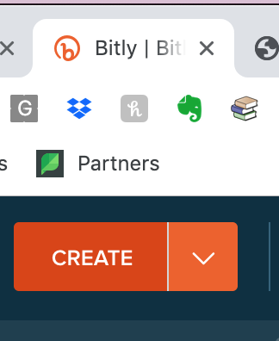
Creating Shortened Links
Head to http://bitly.com
Copy your long link: http://friendschurchnc.org/business/administrative-handbook
Hit ”Create”
Paste your long link
Customize your link if desired (it’s case sensitive)
http://bit.ly/FCNCAdminHandbook

Slide 9
Calls to Action
Calls to action are 2-3 phrases that invite the reader to take a follow up step
Works like a button: you know what to do at a glance
2-3 words: Sign Up, Book Now, Join Us, Donate, Register Today, Reserve Your Spot
Example at Right: “Shop Pool Essentials”

Slide 10
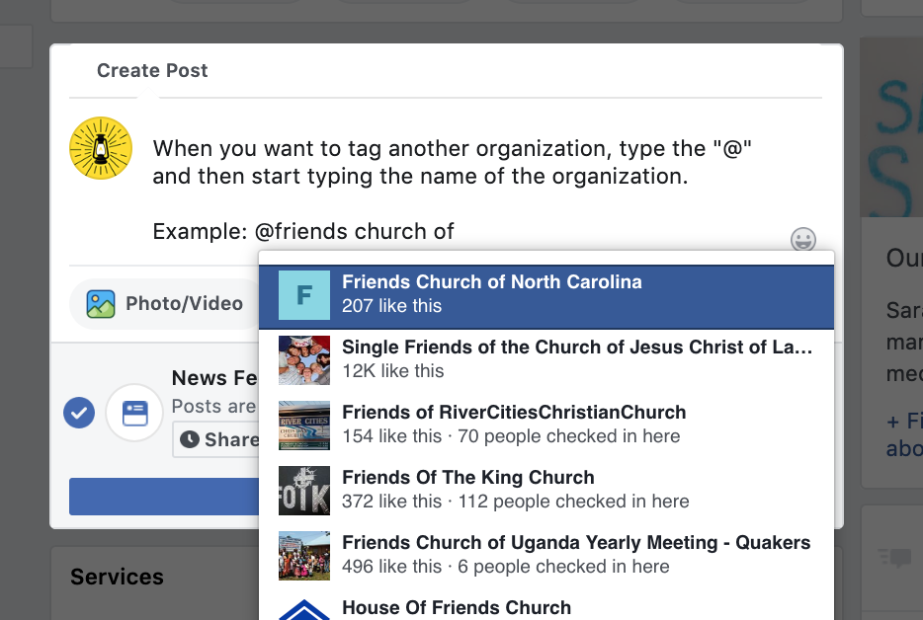
Tagging Other Organizations
Can help get your post in front of other audiences
When you appear in a news article make sure to tag the publication
On Facebook, type an ”@name of organization”
This triggers a dropdown list of Facebook pages. Select name of page to insert tag into post.
This action turns username into hyperlink to that page
Also alerts page administrator!

Slide 11
Helpful Tips
FCNC can tag member meetings and vice versa. Great way to build your audiences!
If you have trouble finding the name in the dropdown list, copy the final part of the page’s URL
That is the page’s username
Then type ”@username” in your post
Etiquette: Avoid tagging a person on a business page
OK to tag a person in a Facebook group!

Slide 12
Beginner Checklist
No more than 2-3 lines of writing: clear, concise, effective
Use shortened web links
Tags other groups when appropriate
Has a clear call to action when you want someone to take action

Slide 13
What Makes a Good Story?

Slide 14
Qualities of a Good Story
Sets a scene
Uses colorful details
Introduces characters
Makes us curious about what happens next
Evokes an atmosphere
Inspires us / makes us feel something
Has a beginning, middle, and end

Slide 15
Example of Post With Good Storytelling
What makes this a good story?
Features a specific Girl Scout in photo and quote
Highlights positive feelings “confidence” and “uniqueness”
Paints a picture “Singing and dancing while I get ready helps me feel empowered”

Slide 16
Example of Post With Good Storytelling
What makes this a good story?
Eye-catching graphic
Explains why applying for a job matters: “soul-satisfying” “great team”
Concise and effective: We’re hiring!

Slide 17
Example of Post With Good Storytelling
What makes this a good story?
Sparks curiosity “How much do you know?”
Invites participation
Uses a clear call to action “Take our quiz”

Slide 18
How do people make a decision to do something?
Whether you’re asking for donations, or inviting people to join you for worship, their decision process may include the following three steps:
Becoming aware of your meeting
Gathering information
Making a decision

Slide 19
How do people make a decision to do something?
Awareness / FEEL
Becoming aware and feel curious about your community
Feel inspired to join in
Consideration / THINK
What are Friends all about?
Do you have programs for children my age?
What’s the parking situation?
When does worship happen?
Action / DO
Join us for Sunday worship
Volunteer
Attend an event

Slide 20
FEEL Example
Images of families having fun
Mission Work and Outreach - stories of the people we have impacted
We packed 40,000 meals in an hour
We changed the lives of kids in Jamaica
Life Celebrations - births, weddings, passages
Challenges that draw us together

Slide 21
FEEL Example
Things that make us excited about worship
Music
Message
Fellowship
Successful FEEL posts inspire a lot of likes and “reactions” (hearts, etc.)
Instagram-style content is often FEEL content

Slide 22
THINK Example
Communicates information about what a specific ritual means in the context of this denomination
Sparks curiosity

Slide 23
THINK Example
Gives the who, what, where, when of how to attend
When is it?
Is there food?
Where is it located?
Are kids welcome?
What should I expect?

Slide 24
DO Examples

Slide 25
> Content Purpose: DO / Clear CTAs

Slide 26
Intermediate - Checklist 2.0
No more than 2-3 lines of copy
Use shortened web links
Tags other groups when appropriate
Has a clear call to action when you want someone to take action
Create a mix of FEEL, THINK, DO content

Slide 27
Defining Voice
Start to identify the attributes that describe your organization as though it were a person?
What first impression do you want to give?
For example are you more friendly or formal?
Are you talking to 40+ or to people under the age of 20? 😀
If you’re in a group, get a lot of post it notes and have everyone write down the attributes that come to mind
Then sort your post its and put them in priority order

