Slide 2
Lunch and Learn Series
1 – How to Set Up a Basic Website
2 – Setting Up a Facebook Page
3 – Using Canva to Create Marketing and Social Media Graphics (TBD)
4 – Creating Email Newsletters with Mailchimp (5/24)
5 – Best Practices for Writing Great Social Media Posts (6/21)
6 – Adapting Content to Save Time (7/19)
7 – Basics of Boosted Posts for Facebook to Reach New Audiences (8/16)
8 – Outreach: Event Promotion Tactics (9/13)
9 – Using Local Search and Google Search to be Found (10/11)

Slide 3
Learning Objectives
Discover the number of US adults who use Facebook
Learn the difference between a page and a group
Learn how to set up a page
Upload a banner image and a logo to page
Create a URL for your page
Fill out your About section on page
Create your first post
Discuss how we get people to “like” page

Slide 4
US Adults Who Use Facebook
Source: https://www.pewinternet.org/fact-sheet/social-media/

Slide 5
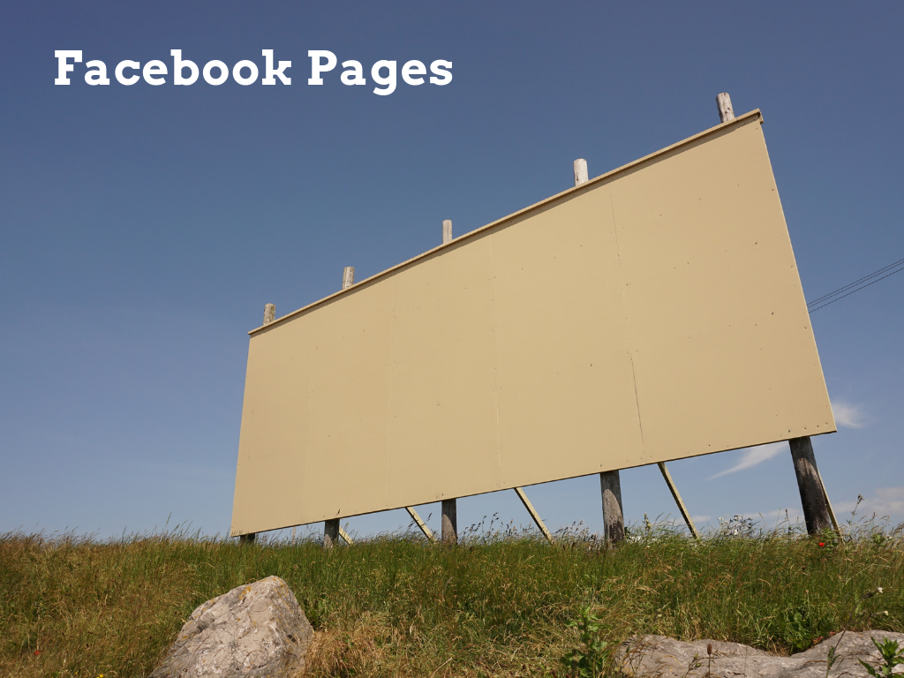

Slide 7
Examples
https://www.facebook.com/MishkanChicago/
https://www.facebook.com/groups/mishkanchicago/

Slide 8
Step One: Gather Your Contact Information
Madison Friends Meeting House
700 University Bay Drive
Madison WI 53705
815-546-4903

Slide 9
Step Two: Create a Banner Image & Square Version of Your Logo
https://www.canva.com
https://sproutsocial.com/insights/social-media-image-sizes-guide/

Slide 10
Example:

Slide 11
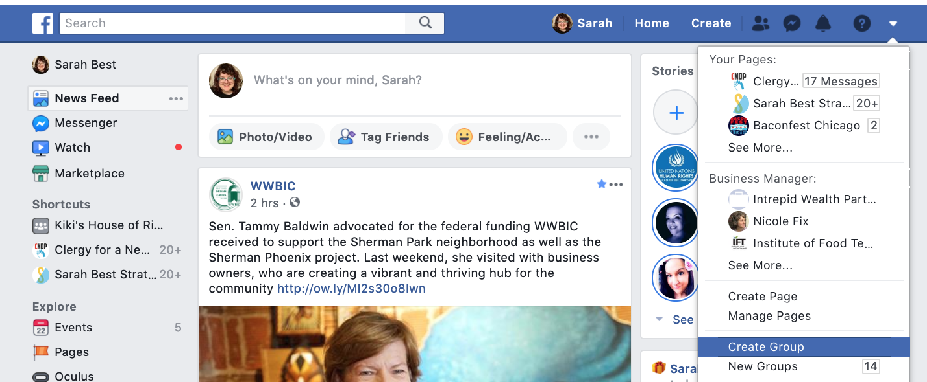
Step Three: Start a Facebook Page or Group
https://www.facebook.com/pages/creation/
For Groups:

Slide 12
Step Four: Create a Username (Your Facebook URL)

Slide 13
Step Five: Complete Your About Section
If this is your billboard, it should have your address on it and a way for people to contact you at a minimum, and a line of copy about who you are, too.
About Us (1 sentence) Example:
A Quaker meeting house in Madison, WI that welcomes all of our neighbors for message, music, fellowship and spiritual growth.

Slide 14
Step Six: Creating Your First Post
Adapt website copy
Good posts are short

Slide 15
Getting People to Like Your Page
List it in your bulletin, post signs
Invite anyone who is currently a friend of yours on Facebook to join the page
Links in your email signature to drive people to a page
You can also put an icon on your website that links back to the page
Verbally asking people
Boost posts to people in your local area

Slide 16
FCNC Facebook Pages and Groups
Facebook Pages
https://www.facebook.com/whiteplainsfriendsmeeting/
https://www.facebook.com/centrefriendsNC/
https://www.facebook.com/ScienceHillFriends/
https://www.facebook.com/Branon-Friends-Youth-160138007357055/
https://www.facebook.com/Thomasville-Friends-Church-FCNC-Quaker-2099906713626347/
https://www.facebook.com/AsheboroFriends/
https://www.facebook.com/DeepCreekFriends/
https://www.facebook.com/concordfriends/
https://www.facebook.com/Cane-Creek-Friends-Meeting-192687240754910/
https://www.facebook.com/backcreekchurch/
Facebook Groups
Rocky River Friends: https://www.facebook.com/groups/971771576249903/
Centre Friends: https://www.facebook.com/groups/130519567809/
Science Hill Friends Meeting Jr. Youth: https://www.facebook.com/groups/248296481871908/
FCNC Missions: https://www.facebook.com/groups/FCNCMissions/

