Slide 1


Title Screen
Part 2

Slide 2
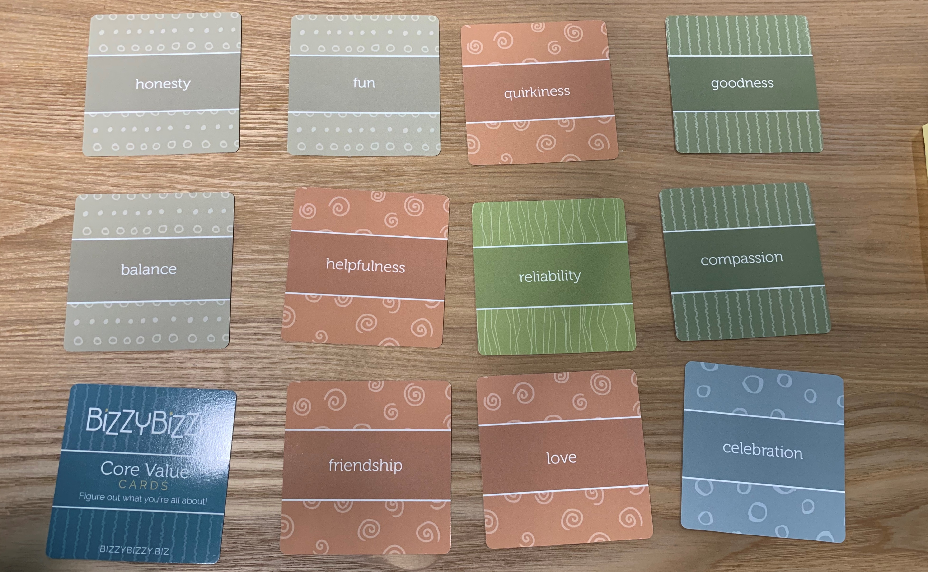

Slide 3
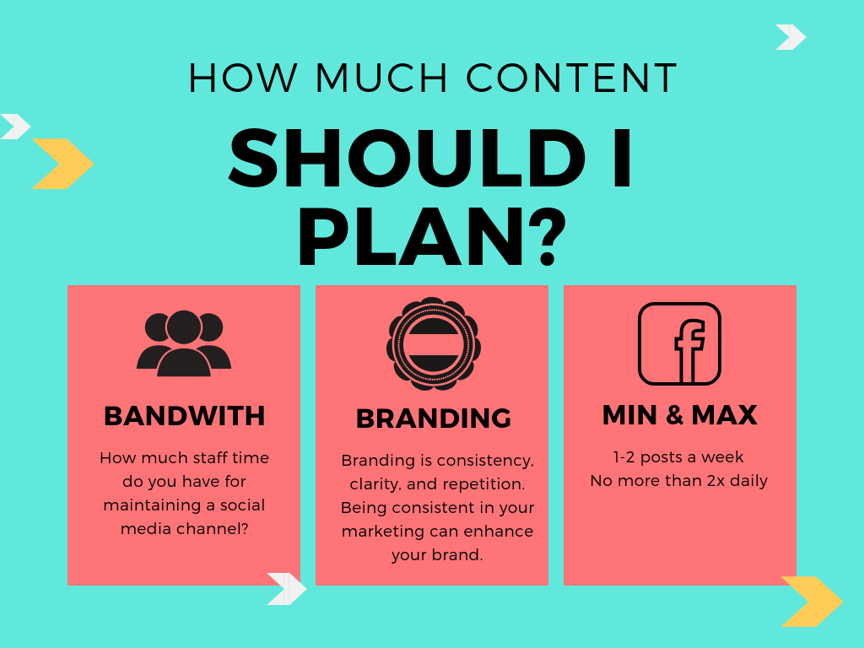

Slide 4
When Should You Post?
Avoid Sundays and Mondays
The best times to post to Facebook are Wednesday at 11 a.m. and 1 p.m.
Wednesday is the best day to post on Facebook.
The safest times to post are weekdays from 9 a.m.–3 p.m.
Sunday has the least amount of engagement for Facebook during the week.
There is an up to 24 hour lag between when you post something on Facebook and when people see it in their newsfeeds
When you start to boost posts this won’t matter as much because your posts will run continuously over a few days

Slide 5


Slide 6
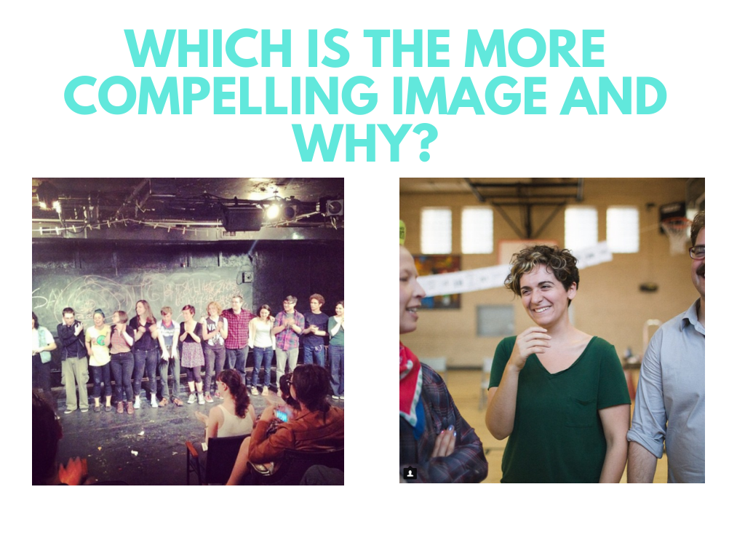

Slide 7
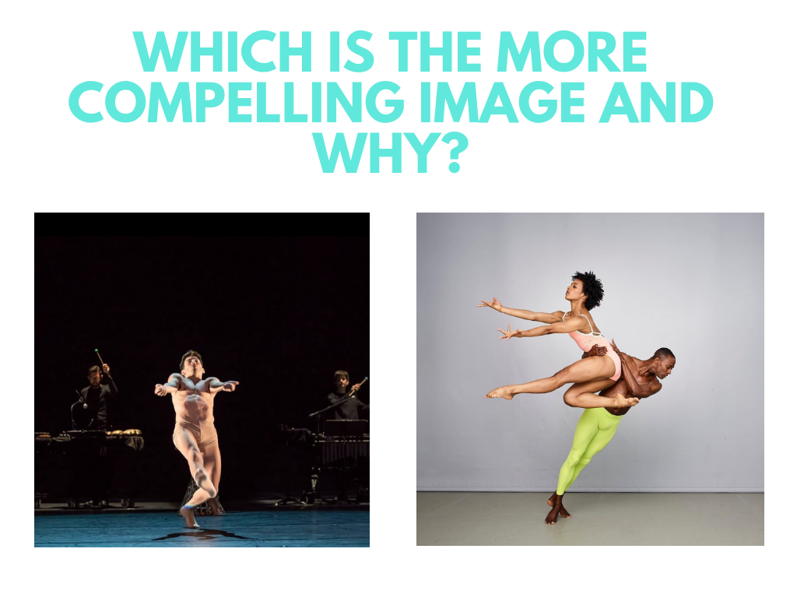

Slide 9
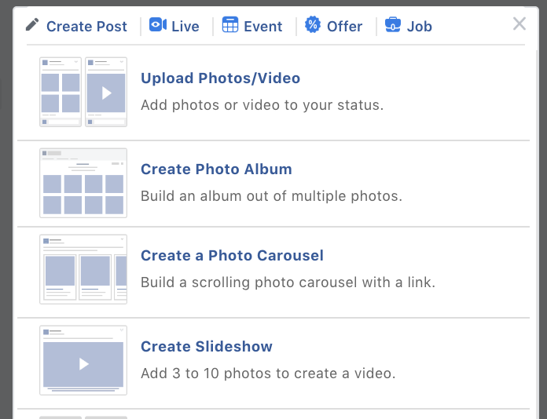
Try slideshows instead of collages
Set transition time in between photos to 3 seconds!

Slide 10
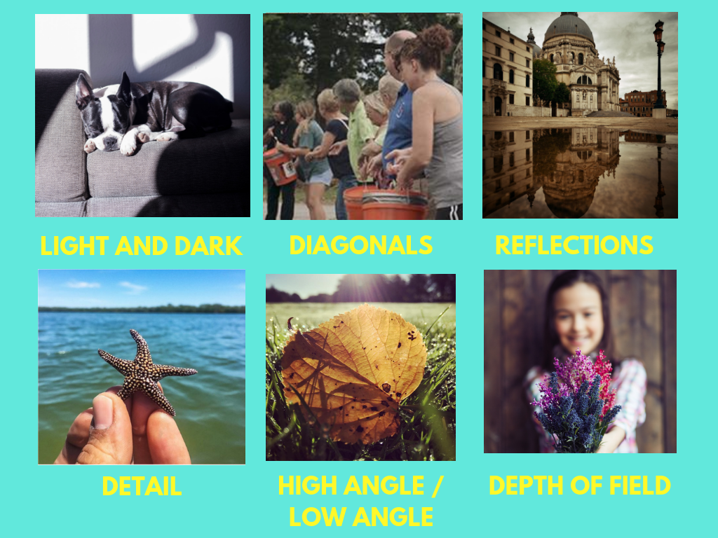

Slide 11
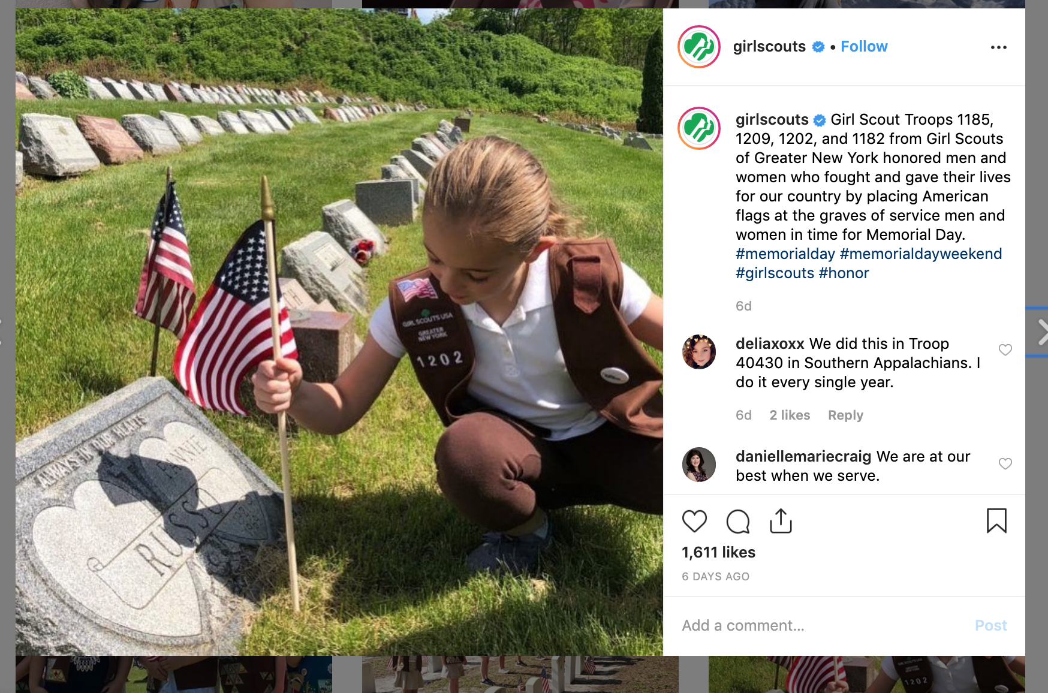
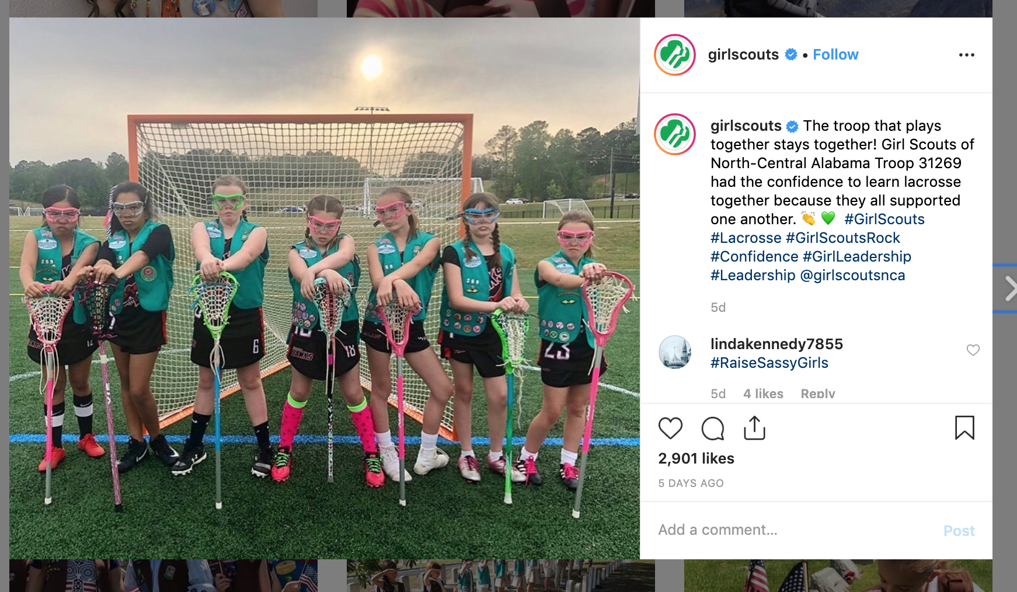
Examples

Slide 12
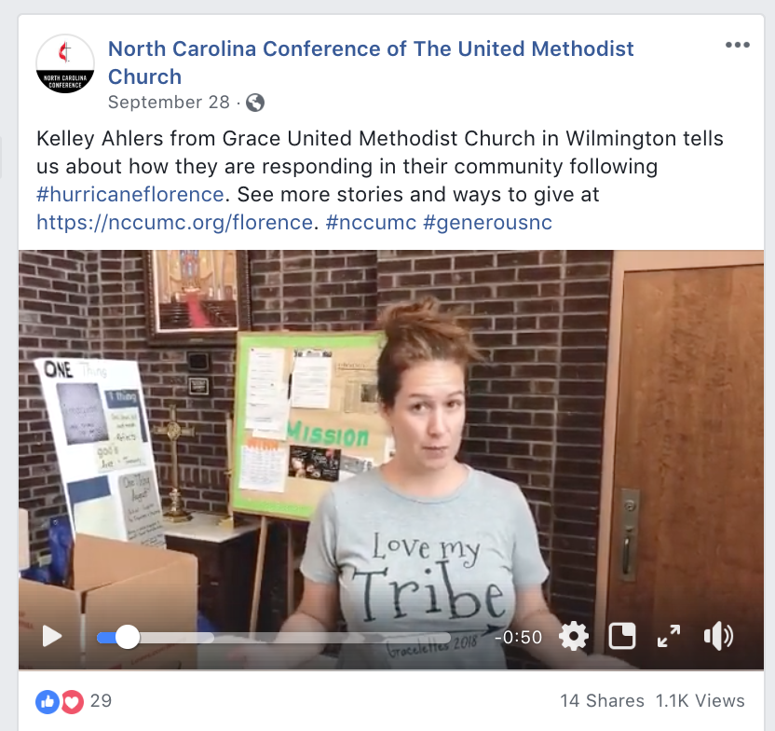
Videos: The Basics
Use natural light when possible
Use a tripod
Use a smart phone or DSLR camera
Think through what you’re going to say ahead of time…or make cue cards!

Slide 13
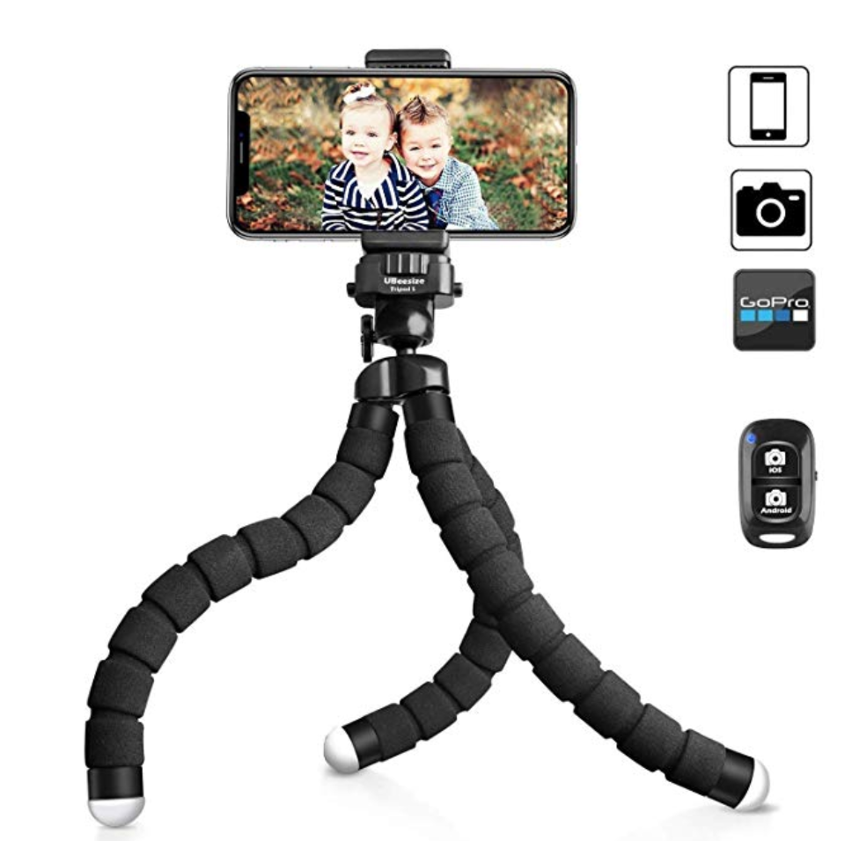
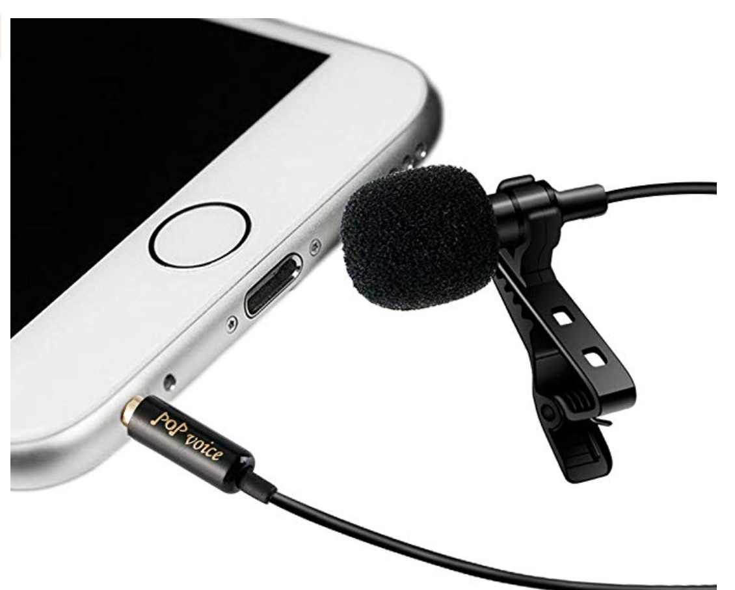
Low Cost Equipment

Slide 14
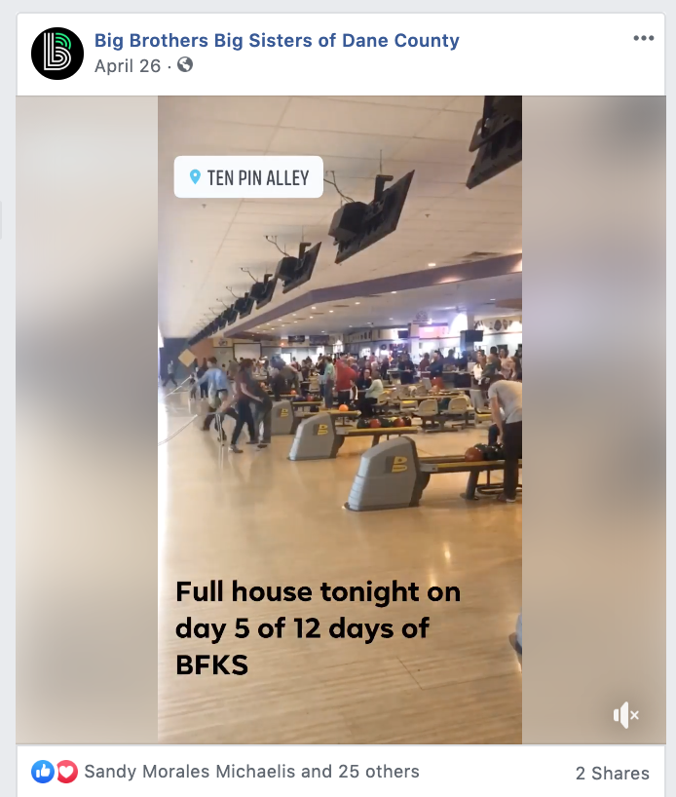
Video Ideas
Interview someone – testimonials - why are you a part of meeting?
Have Pastor speak or answer questions
Video tour of your meeting house
Take someone virtually to an event
Videos can show a simple motion or action in time lapse, slo mo, or boomerang style

Slide 15

When to Use an Event vs. When To Use a Link
Are you selling tickets or does someone have to register?
  Facebook events create awareness and are easy to share
  Facebook post with links to ticketing pages help sell tickets
Eventbrite (free tool) integrates with Facebook events – you can sell tickets within Facebook event. Can be used for free and paid events.

Slide 16
Advanced - Checklist 3.0
No more than 2-3 lines of copy
Use shortened web links
Tags other groups when appropriate
Has a clear call to action when you want someone to take action
Mix of FEEL, THINK, DO content
Strong images with clear point of focus
Experiment with video

Slide 17
