Slide 1
Title Screen

Slide 2
Schedule of Upcoming Sessions
1 – How to Set Up a Basic Website
2– Setting up a Facebook Page
3 – Using Canva to Create Marketing and Social Media Graphics
4 – Creating Email Newsletters with Mailchimp (Today)
5 – Best Practices for Writing Great Social Media Posts (6/21)
6 – Adapting Content to Save Time (7/19)
7 – Basics of Boosted Posts for Facebook to Reach New Audiences (8/16)
8 – Outreach: Event Promotion Tactics (9/13)
9 – Using Local Search and Google Search to be Found (10/11)

Slide 3
Today’s Learning Objectives
Uploading your mailing list
Creating a template and planning content for email and mobile-first considerations
Creating a new campaign, including adding photos, headlines, text, and buttons to your email
Writing a good subject line and avoiding SPAM filters
Testing your emails
How and when to schedule your emails

Slide 4
Does Email Marketing Matter?
92% of online adults use email, with 61% using it on an average day. – Pew Internet Research
You always own your email list
Biggest change in email marketing over the last seven years is mobile readership; 51% of business/non-profit emails will be opened on a mobile device
Emails need to be succinct, make an impression, and include a call to action

Slide 5
Disclosure
We are Mailchimp Agency Partners but do not financially benefit from sharing any of this information with you
Most of what we talk about today should apply to other email marketing systems, too

Slide 6
How Much Does Email Marketing Cost?
Mailchimp:
$0/month for up to 2000 contacts / 1 mailing list, limited template options
$9.99/month for more customer support , more templates, multiple mailing lists, 15% discount for nonprofits
ActiveCampaign:
$9 / month for up to 500 contacts, 20% discount for nonprofits
ConstantContact:
$20/month for up to 500 contacts, 20-30% nonprofit discount available
Emma:
$89/month for 10,000 contacts

Slide 7
For Meetings Without Office Computers
You can design and send emails on a mobile phone and tablet.

Slide 8
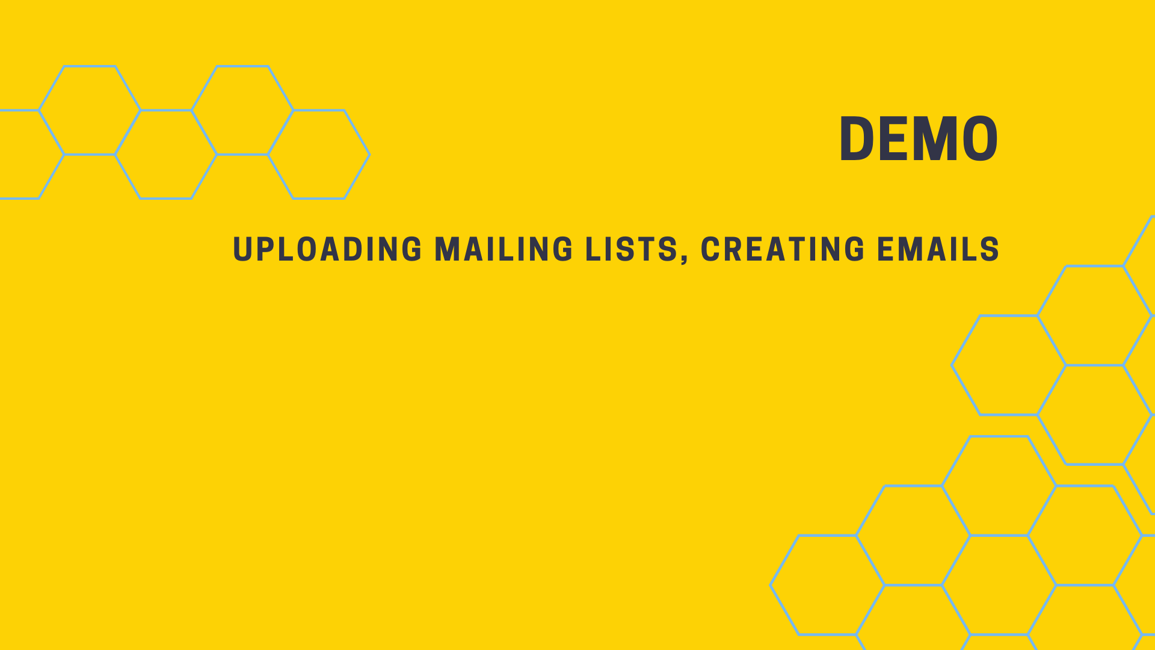
Example Graphic

Slide 9
Creating a New Account
https://login.mailchimp.com/signup/

Slide 10
Orientation
Audiences: Where you go to upload lists, create sign up forms, add and unsubscribe people
Templates: Where you go to make a template, that you can base other emails on
Campaigns: Where you to make a new email newsletter

Slide 11
Sample Content Template
https://docs.google.com/document/d/1j_90V6XCEMYs6r7fqERhhBYO6yjQfIQEUUVw_KApf3A/edit
VIEW ONLY
Matches up with “Tell Your Story” template in Mailchimp
File > Make a Copy to use for your Meeting

Slide 12
Good Subject Lines….
Are short: less than 30 characters / 3-5 words.
Offer a "hook" that evokes curiosity, poses an interesting question, suggests a rich story, creates a gain, or relieves a pain.
Good subject lines use active tense verbs.
Good subject lines create a sense of urgency.
Sometimes includes personalization - could be as simple as "you're invited."
Emojis can increases open rate but I think it depends on your audience
Comes from a familiar sender.
Avoid terms that trigger SPAM filters like "free”.

Slide 13
Good Subject Lines….
Church-specific examples: http://www.umcom.org/learn/tips-for-getting-people-to-open-and-read-your-email
Use fascination: Another Incredible Week.
Ask a question: Why Does Pastor Sarah Do XYZ?
Who is our special guest this week?
Offer pragmatic advice: How to Do Family Worship.
Create urgency: Two Days to Register.
Use seasonal subjects: FALL into XYZ.
Calls to Action: We need you to do XYZ.

Slide 14
SPAM Triggers
View full-size graphic here:
https://www.campaignmonitor.com/assets/uploads/2018/05/coschedule-email-subject-lines-words-decrease-open-rates.jpg.png

Slide 15
When to Send
https://mailchimp.com/resources/insights-from-mailchimps-send-time-optimization-system/
On a weekday
Avoid Mondays
10am – but it’s different for everyone
For Mailchimp paid accounts you can have them send at an “optimal time”

Slide 16
