Slide 2
Schedule of Upcoming Sessions
1 – How to Set Up a Basic Website
2– Setting up a Facebook Page
3 – Using Canva to Create Marketing and Social Media Graphics
4 – Creating Email Newsletters with Mailchimp
5 – Best Practices for Writing Great Social Media Posts
6 – Adapting Content to Save Time
7 – Basics of Boosted Posts for Facebook to Reach New Audiences
8 – Outreach: Event Promotion Tactics (Today)
9 – Using Local Search and Google Search to be Found (11/8)

Slide 3
Learning Objectives
Share some of the results of the FCNC Social Media Audit
Learn the best cadence for promoting events and the best language to use to drive event attendance
We’ll brainstorm different ways to talk about an event to build interest over time
We’ll gain an understanding of defining a target audience for an event and discuss how those audiences can be built in Facebook
Finally, we’ll review a mini marketing plan for an event hosted by a faith community, and get a template for putting your own plan together

Slide 4
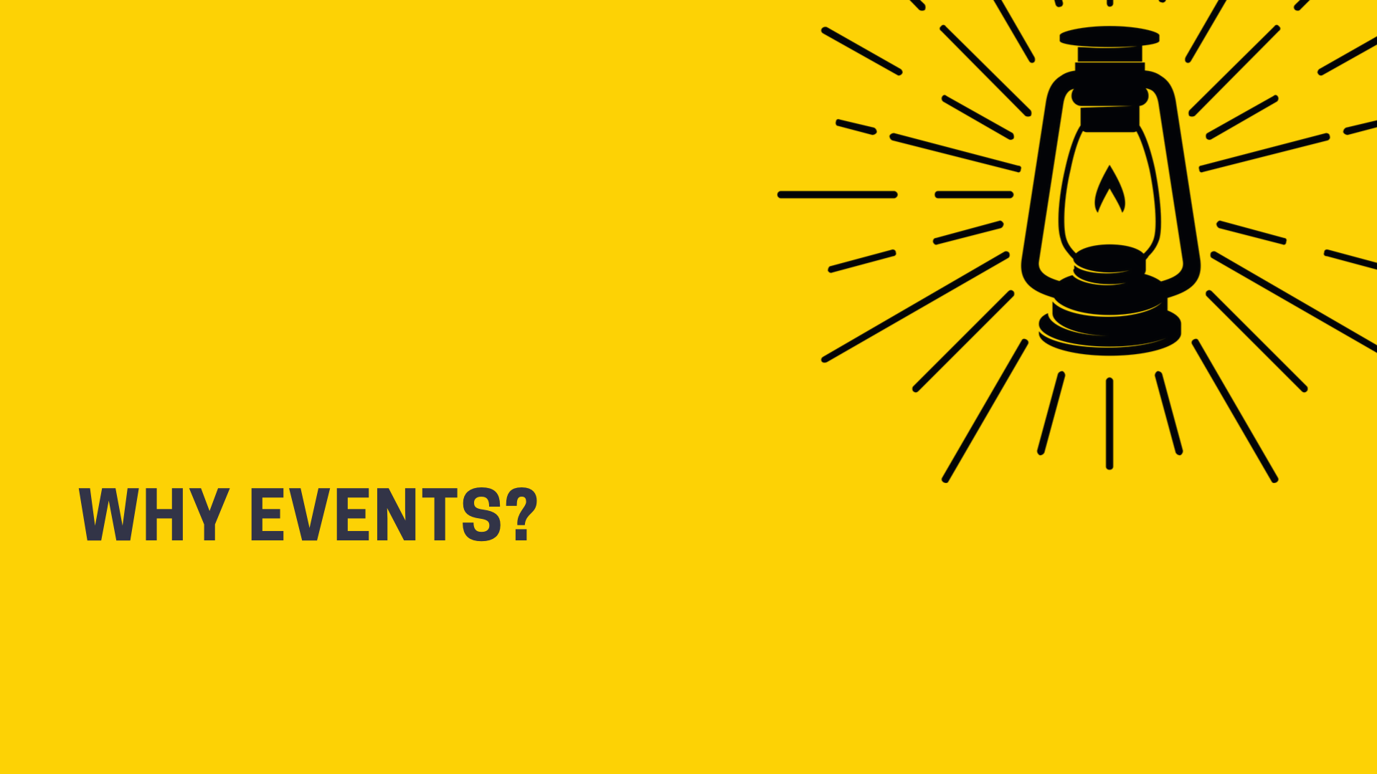

Slide 5
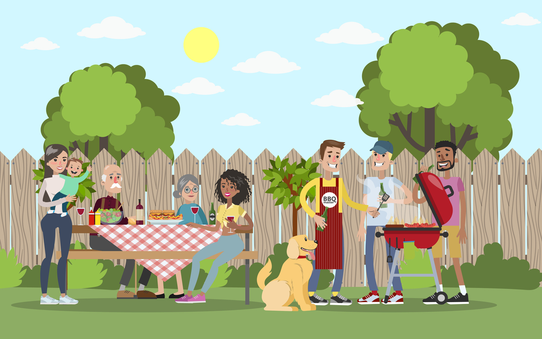
Events are A Tool for Outreach

Slide 6
What in Terms of Outreach Has Been Very Successful?
“Had a free singing group come and served hot dogs at the event, also had trunk or treat for kids that was attended by local families and over 40 kids!”
“We have done a Family Fun Fest in association with Child Evangelism. This involves a day of bounce houses, puppet shows, food, and fun.”
”Homecoming and barbecue dinners.”
“Chicken stews / get togethers in church parking lot.”
”Yard sale. Pinto bean supper. Church picnic.”

Slide 7
Better Event Promotion = Better Outreach Results
The better that we can get at promoting events, the better we can do effective outreach.
Not all events are created equal.
One of the challenges unique to faith communities is having to promote a lot of events, all of the time.
Today, I’m going to ask you to think about events that might need some TLC, where some extra investment in marketing time might result in more effective outreach

Slide 8
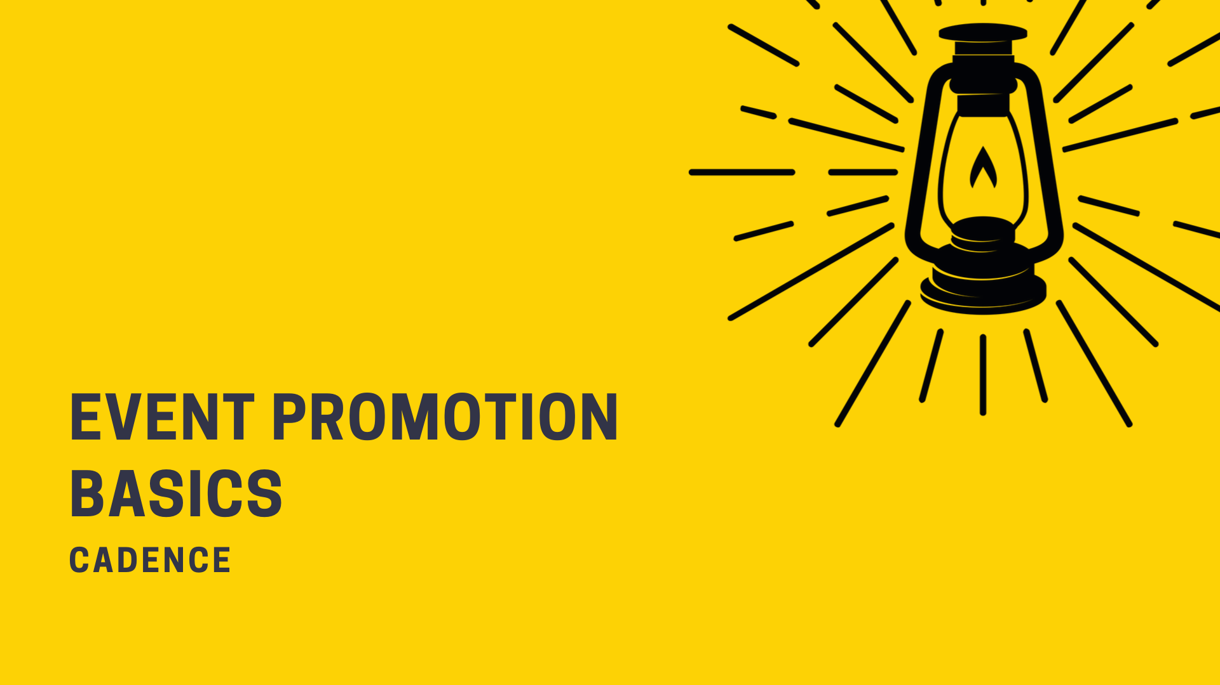

Slide 9
Our Task
When people hear about an event they might think “boy that sounds fun, I’d like to do that SOMEDAY!”
Our task as marketers and outreach people, is to convince them to do that thing TODAY.

Slide 10
Natural Urgency
Notes:
There’s a natural sense of urgency when an event is first announced. It’s new and exciting, and it’s a point when people might buy a ticket for something or add it to their calendar. There’s also a natural sense of urgency within the last 2-3 weeks before an event. If you don’t have to travel, this is when a lot of people are inclined to make decisions about whether or not they will participate.

Slide 11
Natural Urgency
There are points in time when people are most curious about an event.
We should plan on promoting our event at those times! A few reminders is ideal.
Special Event Announced
Tickets On Sale (if applicable)
2-3 Weeks Before an Event
The day of might be too late in a social media context, because people might not see your post until the next day.

Slide 12
Creating Artificial Urgency
What happens in the middle?
We can create artificial urgency using promotional strategies!

Slide 13
Creating Artificial Urgency
Some strategies include:
Early bird ticketing and travel deadlines
Announcing new event details*
Sharing things that are new and different about the event this year *
Getting a story in a local media outlet*
Creating scarcity: Limited time / Limited tickets left (best if this is true!)
* These strategies work even if an event is not ticketed.

Slide 14
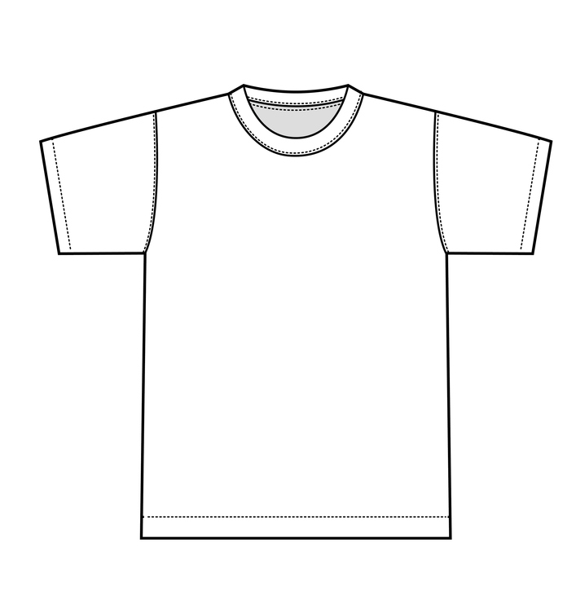
Creating Artificial Urgency
Bundles –sign up for by X date or spend $x more and you’ll also get the speaker’s book, or this year’s church picnic t-shirt.
First 10 families get a swag bag.
Partnerships – Working with a partner to promote your event can bring it to new people.*
Sharing “proof” – quotes, fun photos, video, or reviews of last year’s event.*
Discounts – this is a last resort!
* These strategies work even if an event is not ticketed.

Slide 15
Sold Out!
If an event sells out, this also create urgency!
How can you leverage this?
Set up another event in the series, so that people can sign up now!
This is even true if you’re giving out “free” tickets.
OR Tell people how they can be the first to hear about the next event, such as by signing up for a mailing list or sharing their cell phone number.

Slide 17
Tip: Don’t Make People Hunt for Your Event Info
A common mistake is sending people to a place where they have to hunt around for the event, like a homepage.
Send them to a Facebook event or event page on your website instead.
In marketing, this is called a landing page – a place to “land” after you’ve seen an event notice in a bulletin, on a flyer, heard about it on the radio, or seen it in a social media post.

Slide 18
Where Does Your Audience Hear About Things?
You might send a notice through:
Facebook
Text
Phone Tree
Postcard
Email
Bulletin
PPT Slide
Flier at a local business
Or all of the above!

Slide 19
Review: How Do People Make Decisions?
FEEL
They become aware about an event
They feel excited to attend
They see attractive photos that make them want to attend the event
THINK
Any questions they might have about the event (time, location, ease of parking, will there be food?) have been answered
DO
They’ve been clearly and directly asked to attend
They know what the next step is

Slide 20
There are Many Ways to Talk About an Event
FEEL
Photos and Videos
Heartstrings & Humor
New & Exciting Things for This Year
Understand what the event’s adding to my life
THINK
Informational Posts
“Plan Your Visit” posts
DO
Clear calls to action

Slide 21
Example: Quaker Lake Camp
FEEL
Photos of Campers Having Fun
Quote from a Past Camper
This Year’s New Offerings
Storytelling that communicates positive feelings people get from camp
Nostalgic Posts
THINK
Registration Dates
Location / Directions or Travel Times
Information on Food Served at Camp
DO
Sign Up for Camp!

Slide 22
Review: FEEL / DO Example

Slide 23
Review: THINK Example
Gives the who, what, where, when of how to attend
When is it?
Is there food?
Where is it located?
Are kids welcome?
What should I expect?

Slide 24
Tip: Use Audience-Focused Language
Is there something that would make it difficult for your audience to attend?
Example: Childcare is available!
Is there a concern they may have that keeps them from attending?
Example: Parking is easy! This is our rain date
What’s motivating a particular audience to come?
Come for the fellowship
Meet other Young Quakers
Family-friendly activities

Slide 25
Review: Calls to Action
Calls to action are 2-3 phrases that invite the reader to take a follow up step
Works like a button: you know what to do at a glance
2-3 words: Sign Up, Book Now, Join Us, Donate, Register Today, Reserve Your Spot
Example at Right: “Shop Pool Essentials”

Slide 26
Review: Use a Strong Image

Slide 27
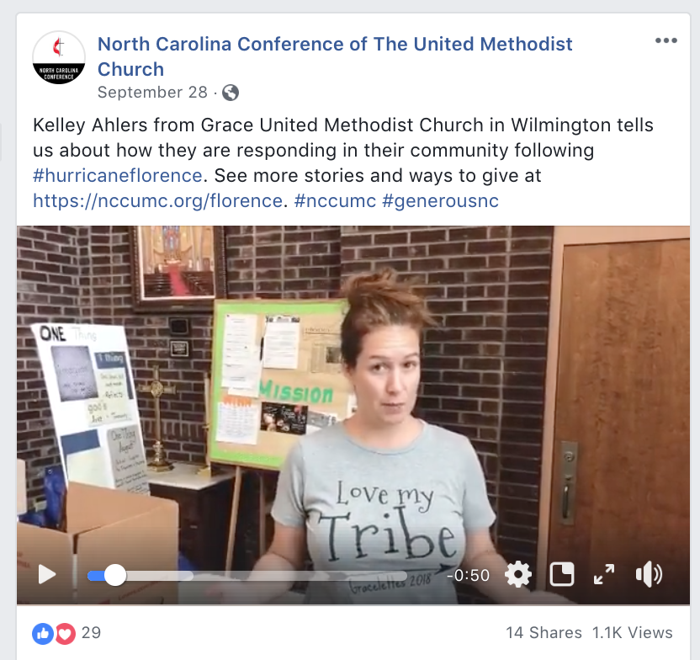
Review: Or a Video
Use natural light when possible
Use a tripod
Use a smart phone or DSLR camera
Think through what you’re going to say ahead of time…or make cue cards!

Slide 28
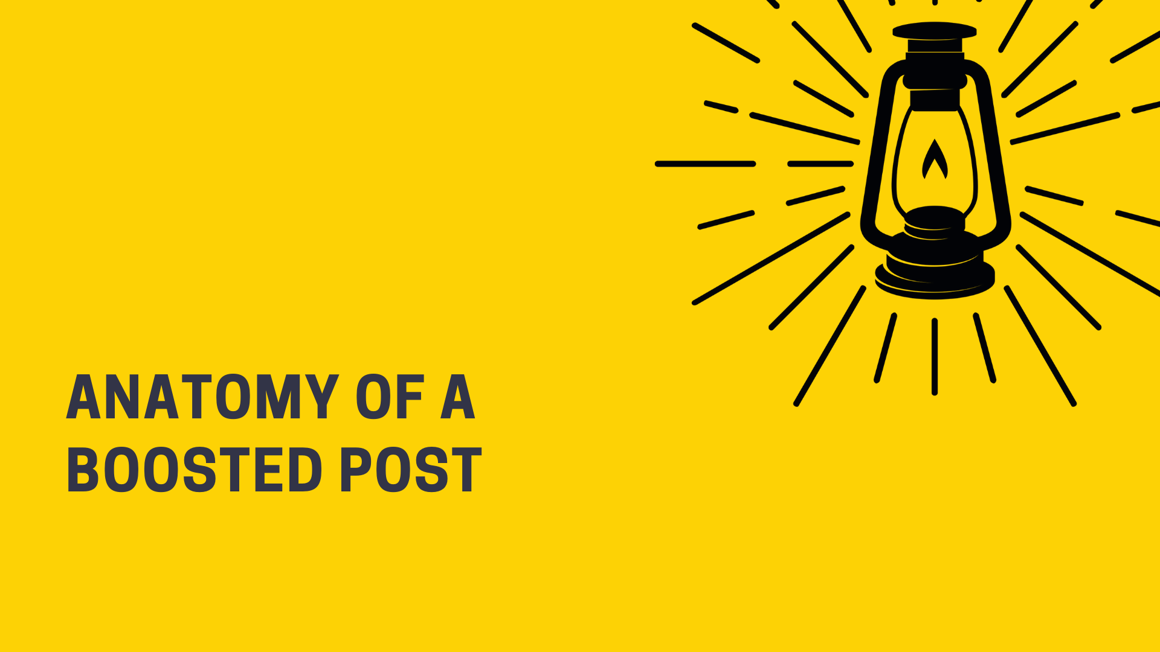
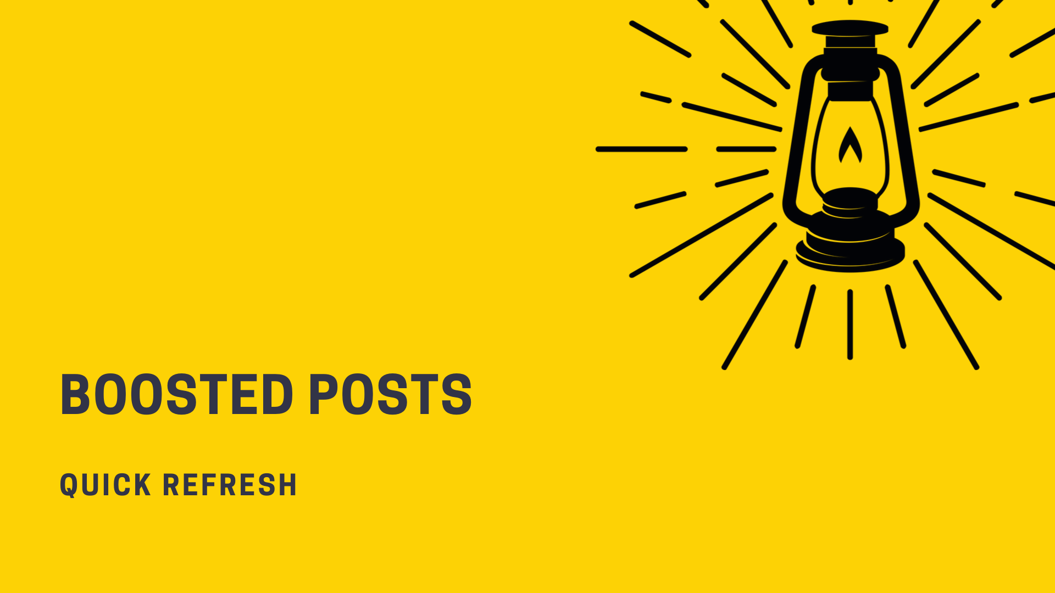

Slide 29
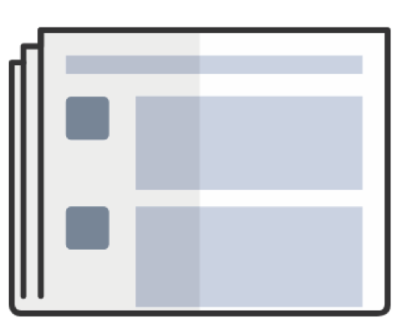
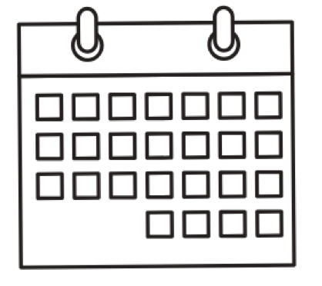
Boosted Posts vs. Boosted Events
Boosted Events
Boosted Posts
Helps build awareness
Integrates with Eventbrite
If you are selling tickets on your website, choose this option and drive traffic to your website objective

Slide 30
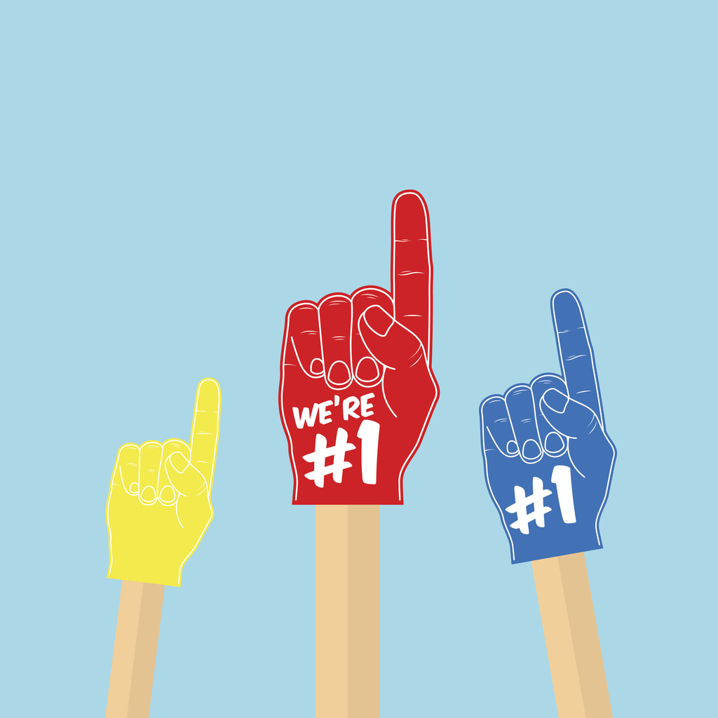
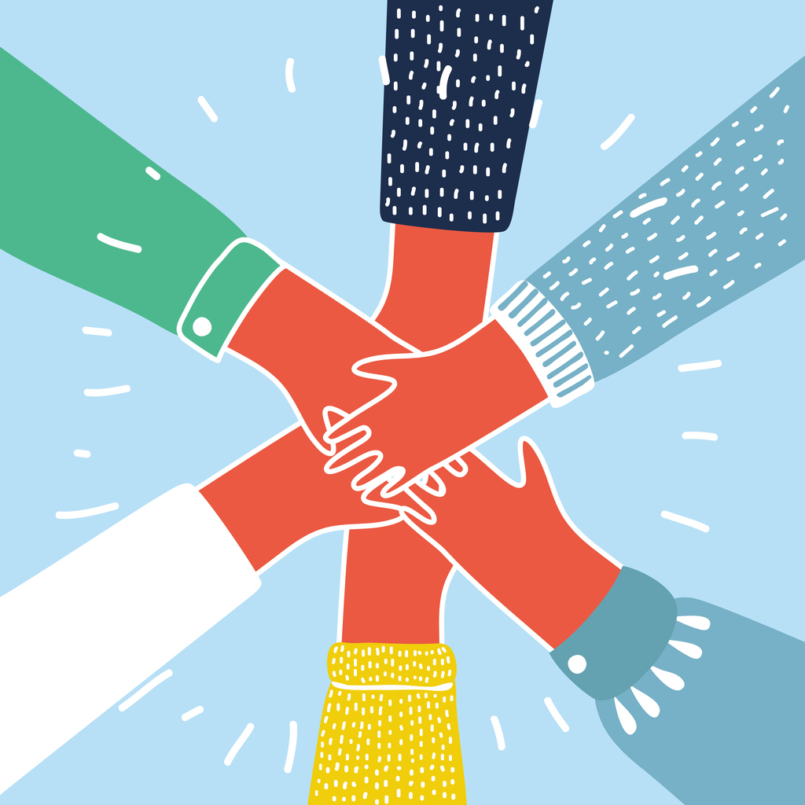
Audience Types: Our Fans vs. Growth
Our Fans
Growth Audiences
People who like our page
People in our Facebook Group
People who visit our website
People who look like our fans
People who share common interests
People who have similar demographic characteristics (like Moms)

Slide 31
You Can Boost a Post to More than One Audience
Boost the Post
Hit the “Boost Again” button
Select a different audience

Slide 32
People in Your Local Audience
This is based off of the address that you’ve set on your page.
You can set a certain radius – 1 mile, 3 miles, 10 miles, etc.
You can optionally set an age range as well.
Good audience for getting foot traffic – for Trunk or Treat, BBQs, special speakers, etc.

Slide 33
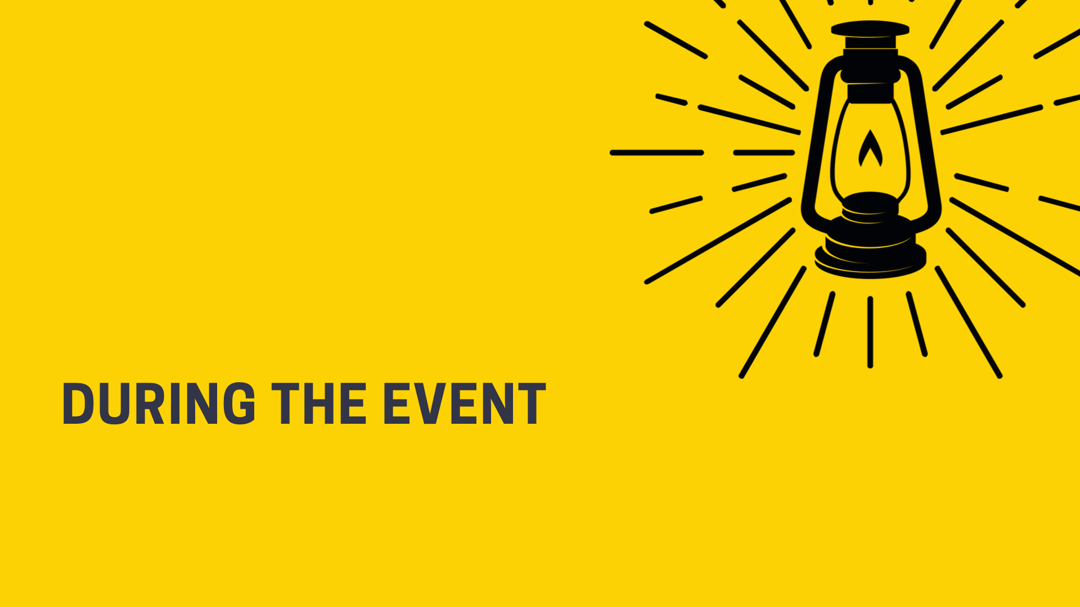
DURING THE EVENT

Slide 34
During the Event
If your goal is to get event attendees to come back, think about what you need to during your event to accomplish that. That might look like:
Having a welcoming table
Verbal announcement
Signage
Handing them something they can take with them, with your website URL on it
Collecting emails or phone numbers

Slide 35
After the Event
Similarly, thinking through how you will follow up with people after the event matters! You might:
Send them a well-designed email or a personal email
Call them
Invite them to a second event, youth group, etc.
Ask for their feedback
Being timely is critical, so think this through ahead of time.

Slide 37
Mini Marketing Plan

Slide 38
Mini Marketing Plan
What is it? April 13, 3-4:30pm, Speaker + Slideshow from Mission Trip Participants
Goals: Share info on mission, deepen engagement, give people a path to get involved
Target Audiences: Seeds of Peace Churches, Open Doors for Refugees, Centro Hispano, UU, Quakers
Value Proposition Statement: First hand stories, bringing likeminded people together
Positioning / Pricing: Free, interfaith coalition
Tools: Website: event page; Partners, Bulletin, Email Newsletter, PPT for Pastors, FB Posts, FB Event
Promotional Budget: Write out budget for boosted posts, printing, etc.
Urgency: Issue in the news, promote within 3 weeks of event happening
Promotional Strategies: Send a press release to local paper, submit an event listing, reach out to partners
Tracking Our Success: Event attendance, how many emails did we collect, how many partners helped
Partnerships: Dane County Sanctuary Coalition, MOSES, Wisconsin Faith Voices for Justice
Retention / Follow Up: Handout, Take Photos at Event, Signs at Event, Event Greeters, Follow Up Email
Roadmap: Prioritize this list, create SMART Goals (Specific, Measurable, Achievable, Relevant, Time Bound)

Slide 39
Mini Marketing Plan (Printable)
What is it?
Goals:
Target Audiences:
Value Proposition Statement:
Positioning / Pricing:
Tools:
Promotional Budget:
Urgency:
Promotional Strategies:
Tracking Our Success:
Partnerships:
Retention / Follow Up:
Roadmap:

