Slide 1
Title Screen

Slide 2
Schedule of Upcoming Sessions
1 – How to Set Up a Basic Website
2– Setting up a Facebook Page
3 – Using Canva to Create Marketing and Social Media Graphics
4 – Creating Email Newsletters with Mailchimp
5 – Best Practices for Writing Great Social Media Posts
6 – Adapting Content to Save Time
7 – Basics of Boosted Posts for Facebook to Reach New Audiences (TODAY)
8 – Outreach: Event Promotion Tactics (10/11)
9 – Using Local Search and Google Search to be Found (11/8)

Slide 3
Learning Objectives
Get step-by-step instructions on how to boost Facebook posts (we’ll talk through it first, then do a demonstration)
Understand when you should consider boosting a post, and for how much money
Be able to define the differences and similarities between Boosted Posts and other Facebook ads
Learn how to set up target audiences
Examine advertising objectives, calls to action, and advertising schedules within a boosted post
Look at sample boosted post results and interpret them

Slide 5
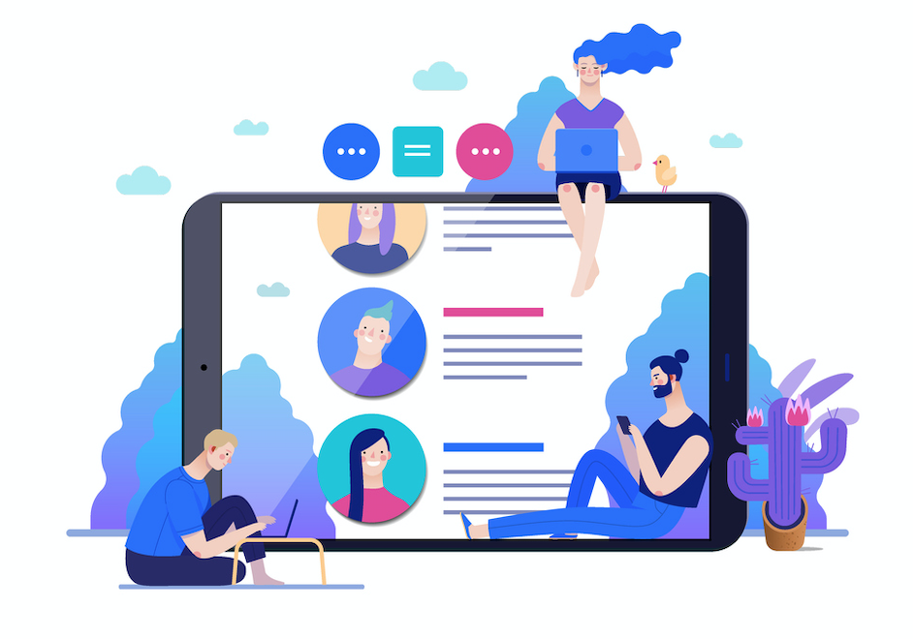
A Tool for Outreach

Slide 6
Who Do You Want to Reach?
How old are they?
What’s their family status?
Where do they live? How far might they drive to get to you?
What are their interests? What sorts of radio stations or TV stations do they listen to? How do they spend their free time?
What are their technology habits?

Slide 7
What Would You Like People to Do?
Buy a ticket
Attend an event
Gain understanding of who you are and what you’re all about
Get excited to join in
Tell their friends
Visit your website

Slide 8
Why Boosted Posts?
Helps you reach fans of your Facebook page
Helps you reach people you don’t know yet in your community
Costs very little - $5+
Easy to do – should take about 5 minutes at the most
69% of US Adults use Facebook

Slide 9
What Do You Need to Get Started?
To boost a post you need to have access to a Facebook Page
You also need to have an advertising account
Personal Facebook Account: Go to: Manage Ads to get started.
Facebook Business Manager: Go to business.facebook.com to get started
You cannot boost posts within a Group

Slide 10
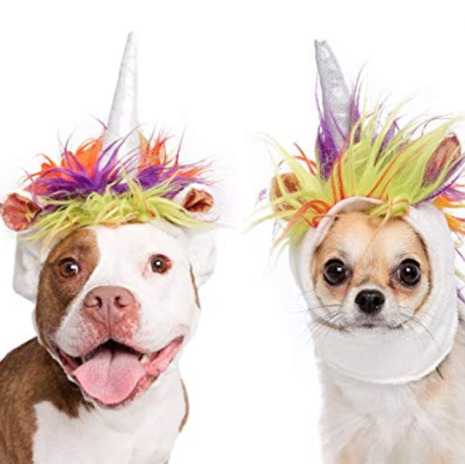
Aren’t Facebook Ads Better than Boosted Posts?
Myths
Facts
Facebook ads are better (or worse) than boosted posts
Boosted posts are the same as Facebook ads
They offer a simpler set of options

Slide 12
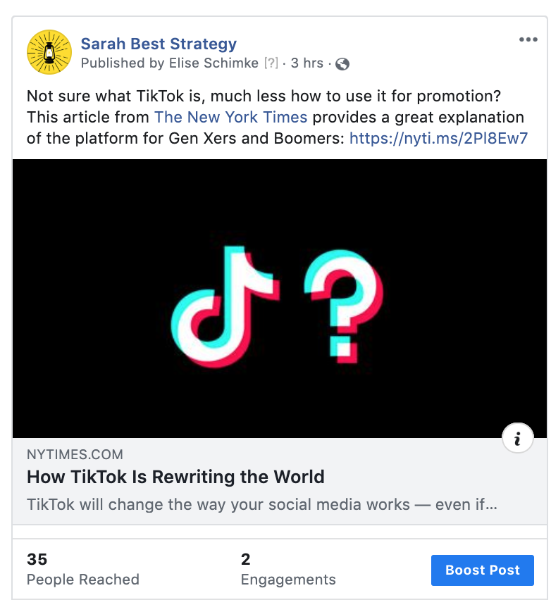
What Does a Boosted Post Look Like?

Slide 13
Objective or Goals
Do you want to send people to your website?
Do you want to get more people to like, comment, and share your post?
Do you want to get people to watch a video?
Do you want people to send you messages through Facebook Messenger?

Slide 14
Link Posts = Access to Web Traffic Objective

Slide 15
Photo Posts = Access to Likes + Shares Only

Slide 16
When Does Each Objective Make Sense?
Want people to go to website or buy tickets to event. Link Clicks
Celebrating someone’s life. Shares + Likes
Want people to watch video. Video Views.
Do you want people to send you messages through Facebook Messenger? Usually doesn’t make sense.

Slide 17
Post Buttons
For any posts that drives traffic to a website, you can choose from a number of buttons.
These reinforce your call to action:
Learn More
Sign Up
Get Directions

Slide 18
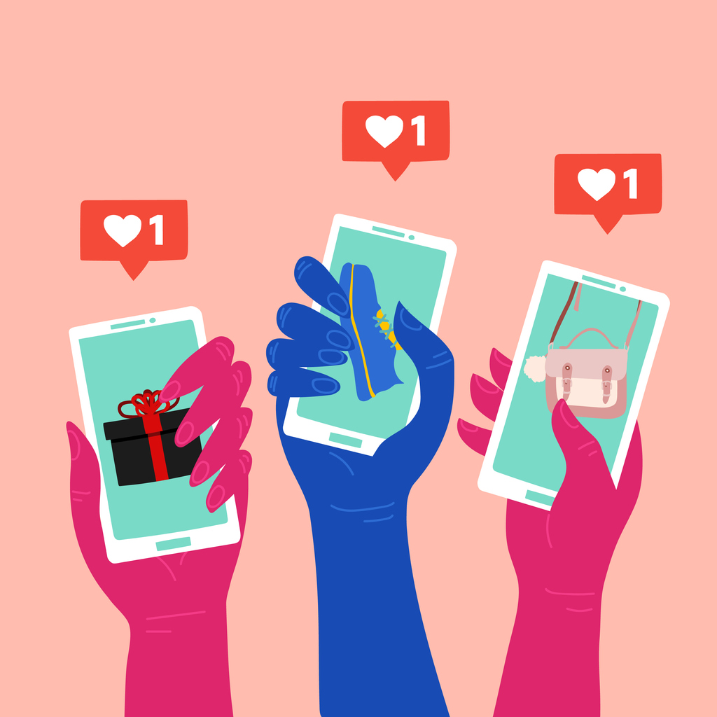
Placements
This is a fancy way of saying: where do you want the ads to run?
Facebook
Instagram
Facebook Messenger
Tip: Facebook will try to pick this for you! Don’t let them! Toggle “off” Automatic Placements
Think back to your audience’s technology habits

Slide 19
Duration and Budget
Duration and Budget lets you define how long you want the ad to run, and what your total budget is.
Scenario A: 4 days at $5-10 – works for most posts
Scenario B: 10 days at $50 – for bigger events or outreach efforts

Slide 21
Advertising is a Broad Medium
Each person can only see a limited number of ads per day.
There’s a lot of competition!
So our audience size also has to be pretty broad.
Shoot for audiences of 50,000+
Easiest way to do this is to target a television viewing area instead of a city.

Slide 22
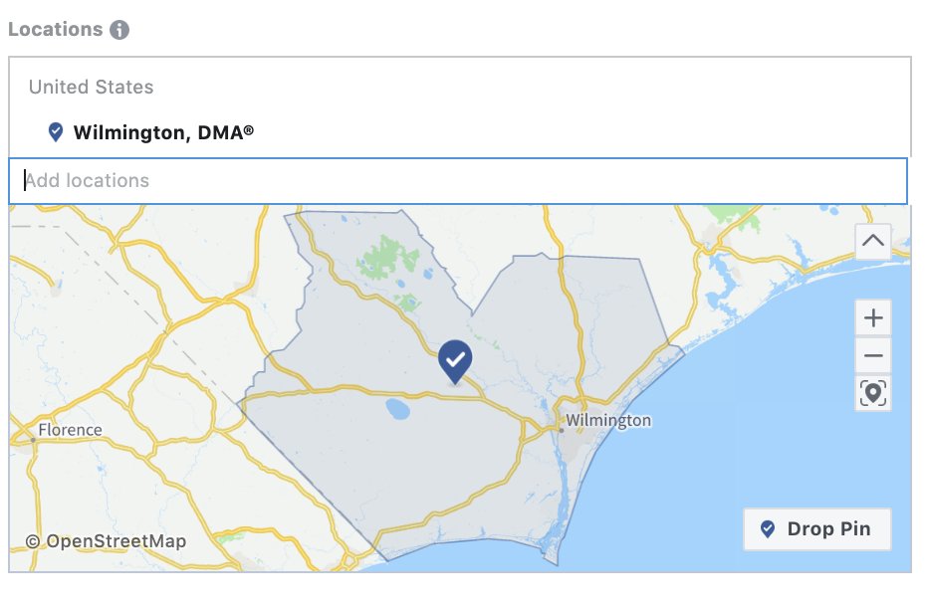
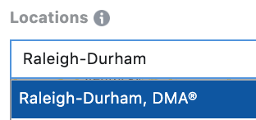
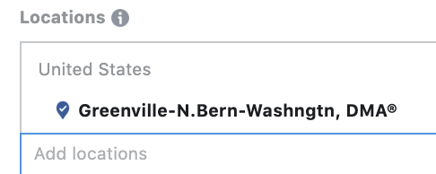
North Carolina TV Viewing Markets
Charlotte DMA
Raleigh-Durham DMA
Greensboro-High Point-Winston Salem DMA (abbrev.)
Greenville-New Bern-Washington DMA (abbrev.)
Wilmington DMA
Your television viewing market may be in a different state if you’re near the border: https://en.wikipedia.org/wiki/List_of_television_stations_in_North_America_by_media_market

Slide 23
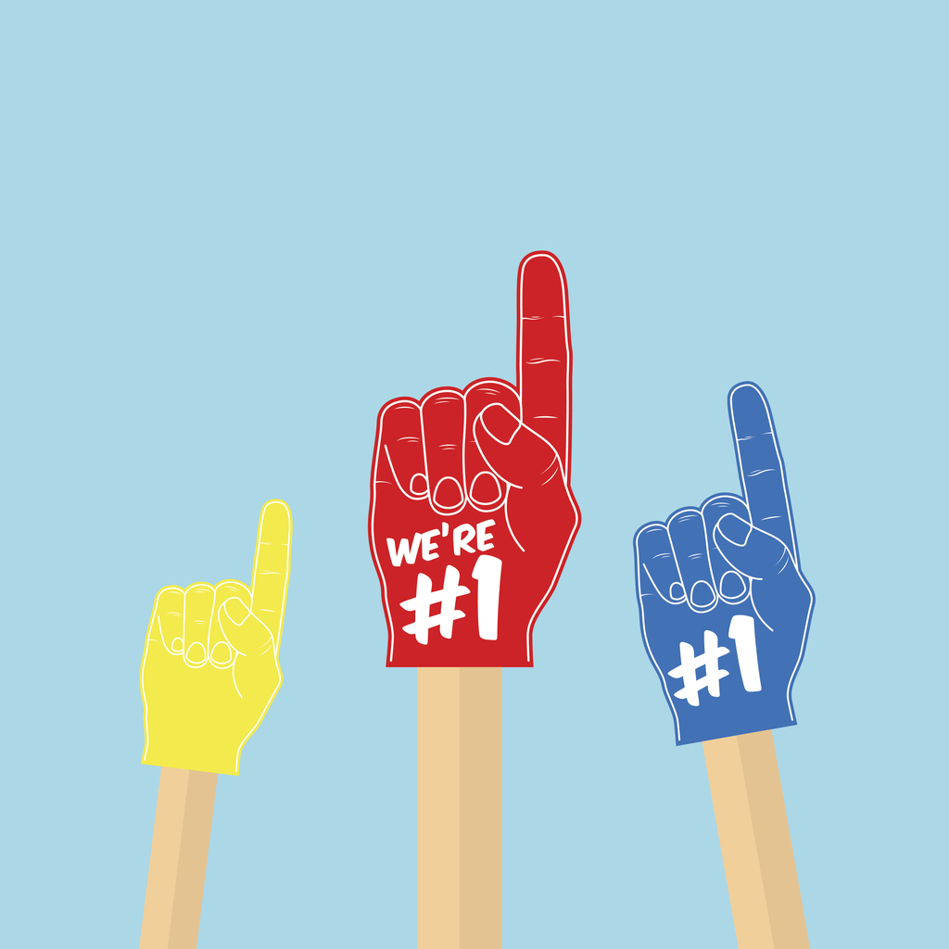
Audience Types: Our Fans vs. Growth
Our Fans
Growth Audiences
People who like our page
People in our Facebook Group
People who visit our website
People who look like our fans
People who share common interests
People who have similar demographic characteristics (like Moms)

Slide 24
Who Do You Want to Reach?
Some boosted posts might be targeted to your fans…so that your meeting members see your posts and feel excited to participate.
Some boosted posts might be targeted to groups of people in your community such as: all of your neighbors, parents of small kids, people who share certain interests (like peace!)

Slide 25
You Can Boost a Post to More than One Audience
Boost the Post
Hit the “Boost Again” button
Select a different audience

Slide 26
People Who Like Our Page
You can specify geographic location.
Good audience for distributing your content and keeping people informed and engaged.

Slide 27
People in Your Local Audience
This is based off of the address that you’ve set on your page.
You can set a certain radius – 1 mile, 3 miles, 10 miles, etc.
You can optionally set an age range as well.
Good audience for getting foot traffic – for Trunk or Treat, BBQs, special speakers, etc.

Slide 28
Creating A New Audience
You can create and save new audiences that share certain demographic characteristics or interests
Save the audience to be able to access it anytime
Make sure to give it a good name that you’ll remember later on

Slide 29
Some Helpful Audiences: Parents
Hit “Browse” under detailed targeting
Select “All Parents” or specific age range

Slide 30
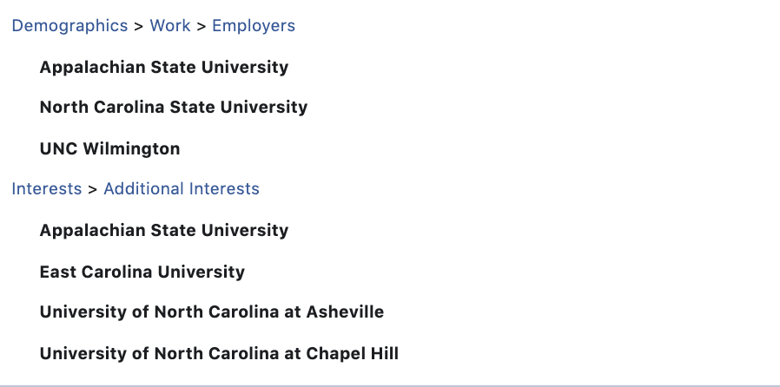
Some Helpful Audiences: Students
You can target people who are currently attending certain colleges (Schools)
People who work at colleges (Employers)
Alumni and Community Members (Interests)

Slide 31
Some Helpful Audiences: Multicultural Affinity
If you are trying to do outreach in a community that has a large African American, Asian American, or Hispanic population, this can help you reach those folks

Slide 32
Some Helpful Audiences: Interests
People who have an interest in:
Certain television stations or radio stations (NPR, PBS)
People who are interested in Quakerism, Peace, or Mission Work
People who are interested in Service Organizations (Rotary International) or Charity Organizations (American Red Cross)
People who follow other Christian denominations (United Methodists Volunteers in Action)

Slide 33
Geographic Targets, Gender, and Age
While television targets are nice and broad, you can also target by city and even zip code!
In most cases, I’d advise not narrowing the audience by age or gender so that you can keep it as broad as possible
In some cases (Quaker Men, Quaker Women), it might make sense to narrow a bit but keep an eye on the audience size.

Slide 34
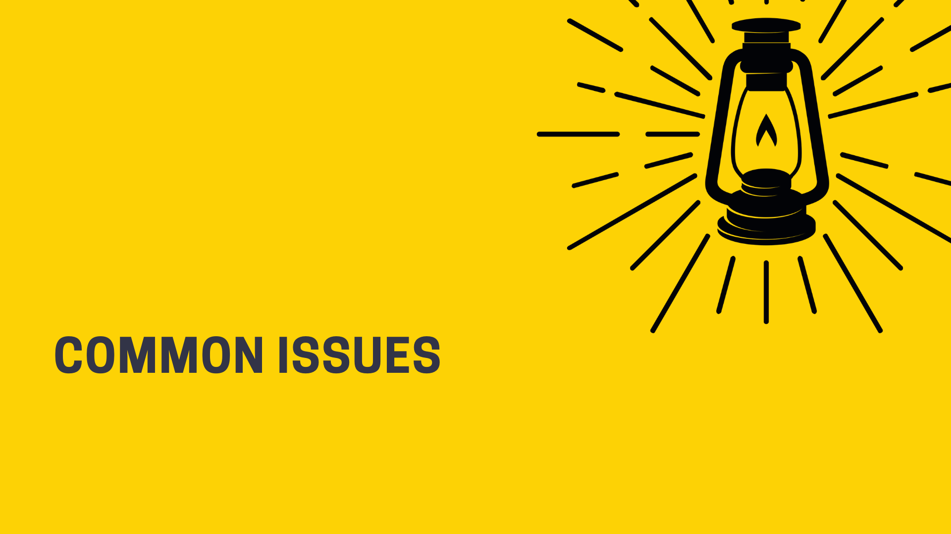

Slide 35
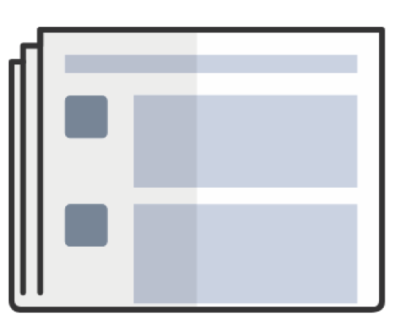
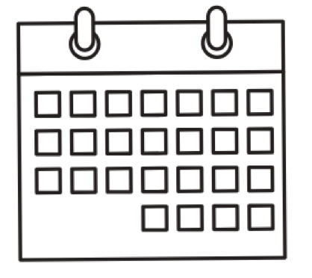
Boosted Posts vs. Boosted Events
Boosted Events
Boosted Posts
Helps build awareness
Integrates with Eventbrite
If you are selling tickets on your website, choose this option and drive traffic to your website objective

Slide 36
Advertising Policies
The most common reason an ad will not be approved is if there is too much text in the image
Avoid graphics that look like newspaper circulars or flyers
Use simple graphics and photography
Test your image here: https://facebook.com/ads/tools/text_overlay
The word “you” sometimes also triggers ad rejection

Slide 37
More on That…
OK: Looking for Quakers near you?
OK: Learn about Quaker values
Not okay: Are you Quaker?
Not okay: Meet other Quakers
OK: Referencing Quakers
Not okay: Implying that the viewer is Quaker
Here’s the full set of policies:
https://www.facebook.com/policies/ads/

Slide 38
“Issues of Public Importance”
Recently Facebook also started flagging posts with “issues of public importance”
Those include:
civil and social rights
crime
economy
education
environmental politics
guns
health
immigration
political values and governance
security and foreign policy
To boost posts on those topics, you have to verify your identify with a state ID, and take a few other steps: https://www.facebook.com/policies/ads/restricted_content/political

Slide 39
What is a Pixel?
A pixel is a little bit of code a web developer can put on every page of your website
Can help you make an audience of website visitors or people who look like your website visitors
More advanced – don’t need to worry about this if you are just getting started

Slide 40
Editing, Rescheduling, and Deleting Boosts

Slide 41
Interpreting Results

