Slide 1


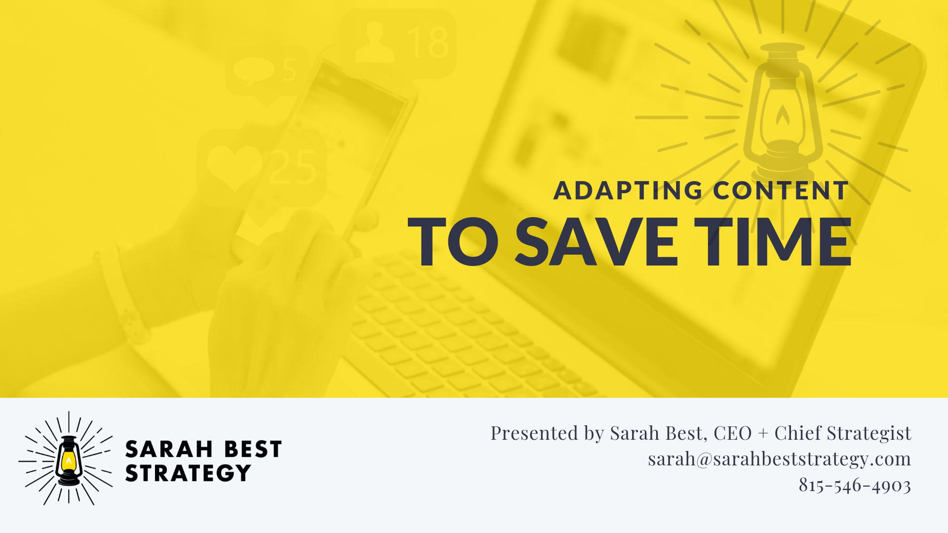
Title Screen

Slide 2
Schedule of Upcoming Sessions
1 – How to Set Up a Basic Website
2– Setting up a Facebook Page
3 – Using Canva to Create Marketing and Social Media Graphics
4 – Creating Email Newsletters with Mailchimp
5 – Best Practices for Writing Great Social Media Posts
6 – Adapting Content to Save Time (TODAY)
7 – Basics of Boosted Posts for Facebook to Reach New Audiences (9/13)
8 – Outreach: Event Promotion Tactics (10/11)
9 – Using Local Search and Google Search to be Found (11/8)

Slide 3
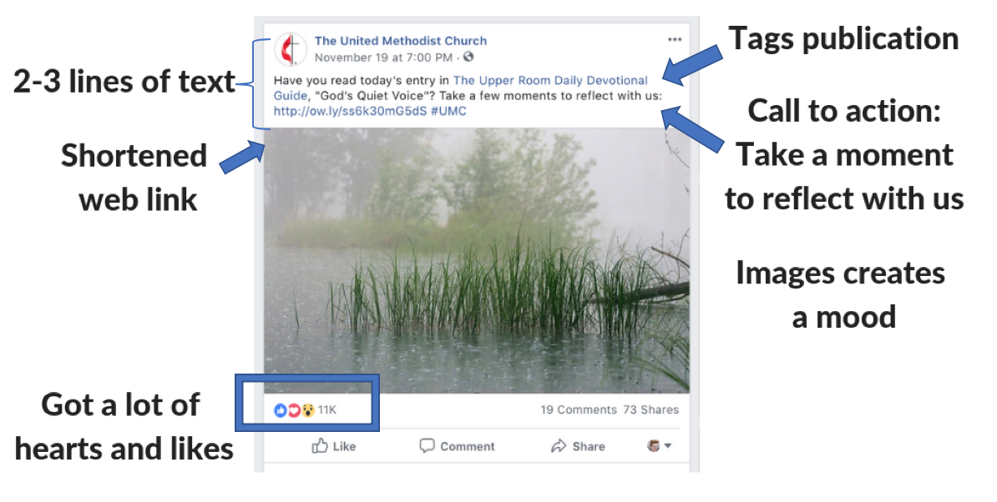
Last Time We Discussed How to Write Quality Social Media Posts

Slide 4
Today: Content Planning
We’re going to discuss how to plan content so that it is:
  Time Efficient
  Strategic
  Consistent Across Communications Channels

Slide 5
Learning Objectives
Create a content buckets checklist to help you with content planning
Learn the six key questions you need to ask when planning social media content
See a sample month’s plan
Get some tips for planning content as a group
Get practical advice on adapting website or brochure content for emails, social media, bulletin notices, and more
Discover evergreen content and how it can save you time

Slide 6


Slide 7
Step One: Identify Content Buckets
Outline all of the topics you tend to talk about on a regular basis
  Example: Christian Education, Weekly Meetings, Fellowship Groups
Organize it in a checklist!
Removes the guesswork from planning
You only have to develop a checklist once, or once a year

Slide 8
Example of Content Buckets: Big Brothers Big Sisters
Events
Calls to Action: Volunteer / Register a Child / Donate
Big / Little Success Stories
Impact of Work: Facts and Stats
Programs
Volunteer FAQ
Resources for Mentors
Audience Milestones

Slide 9
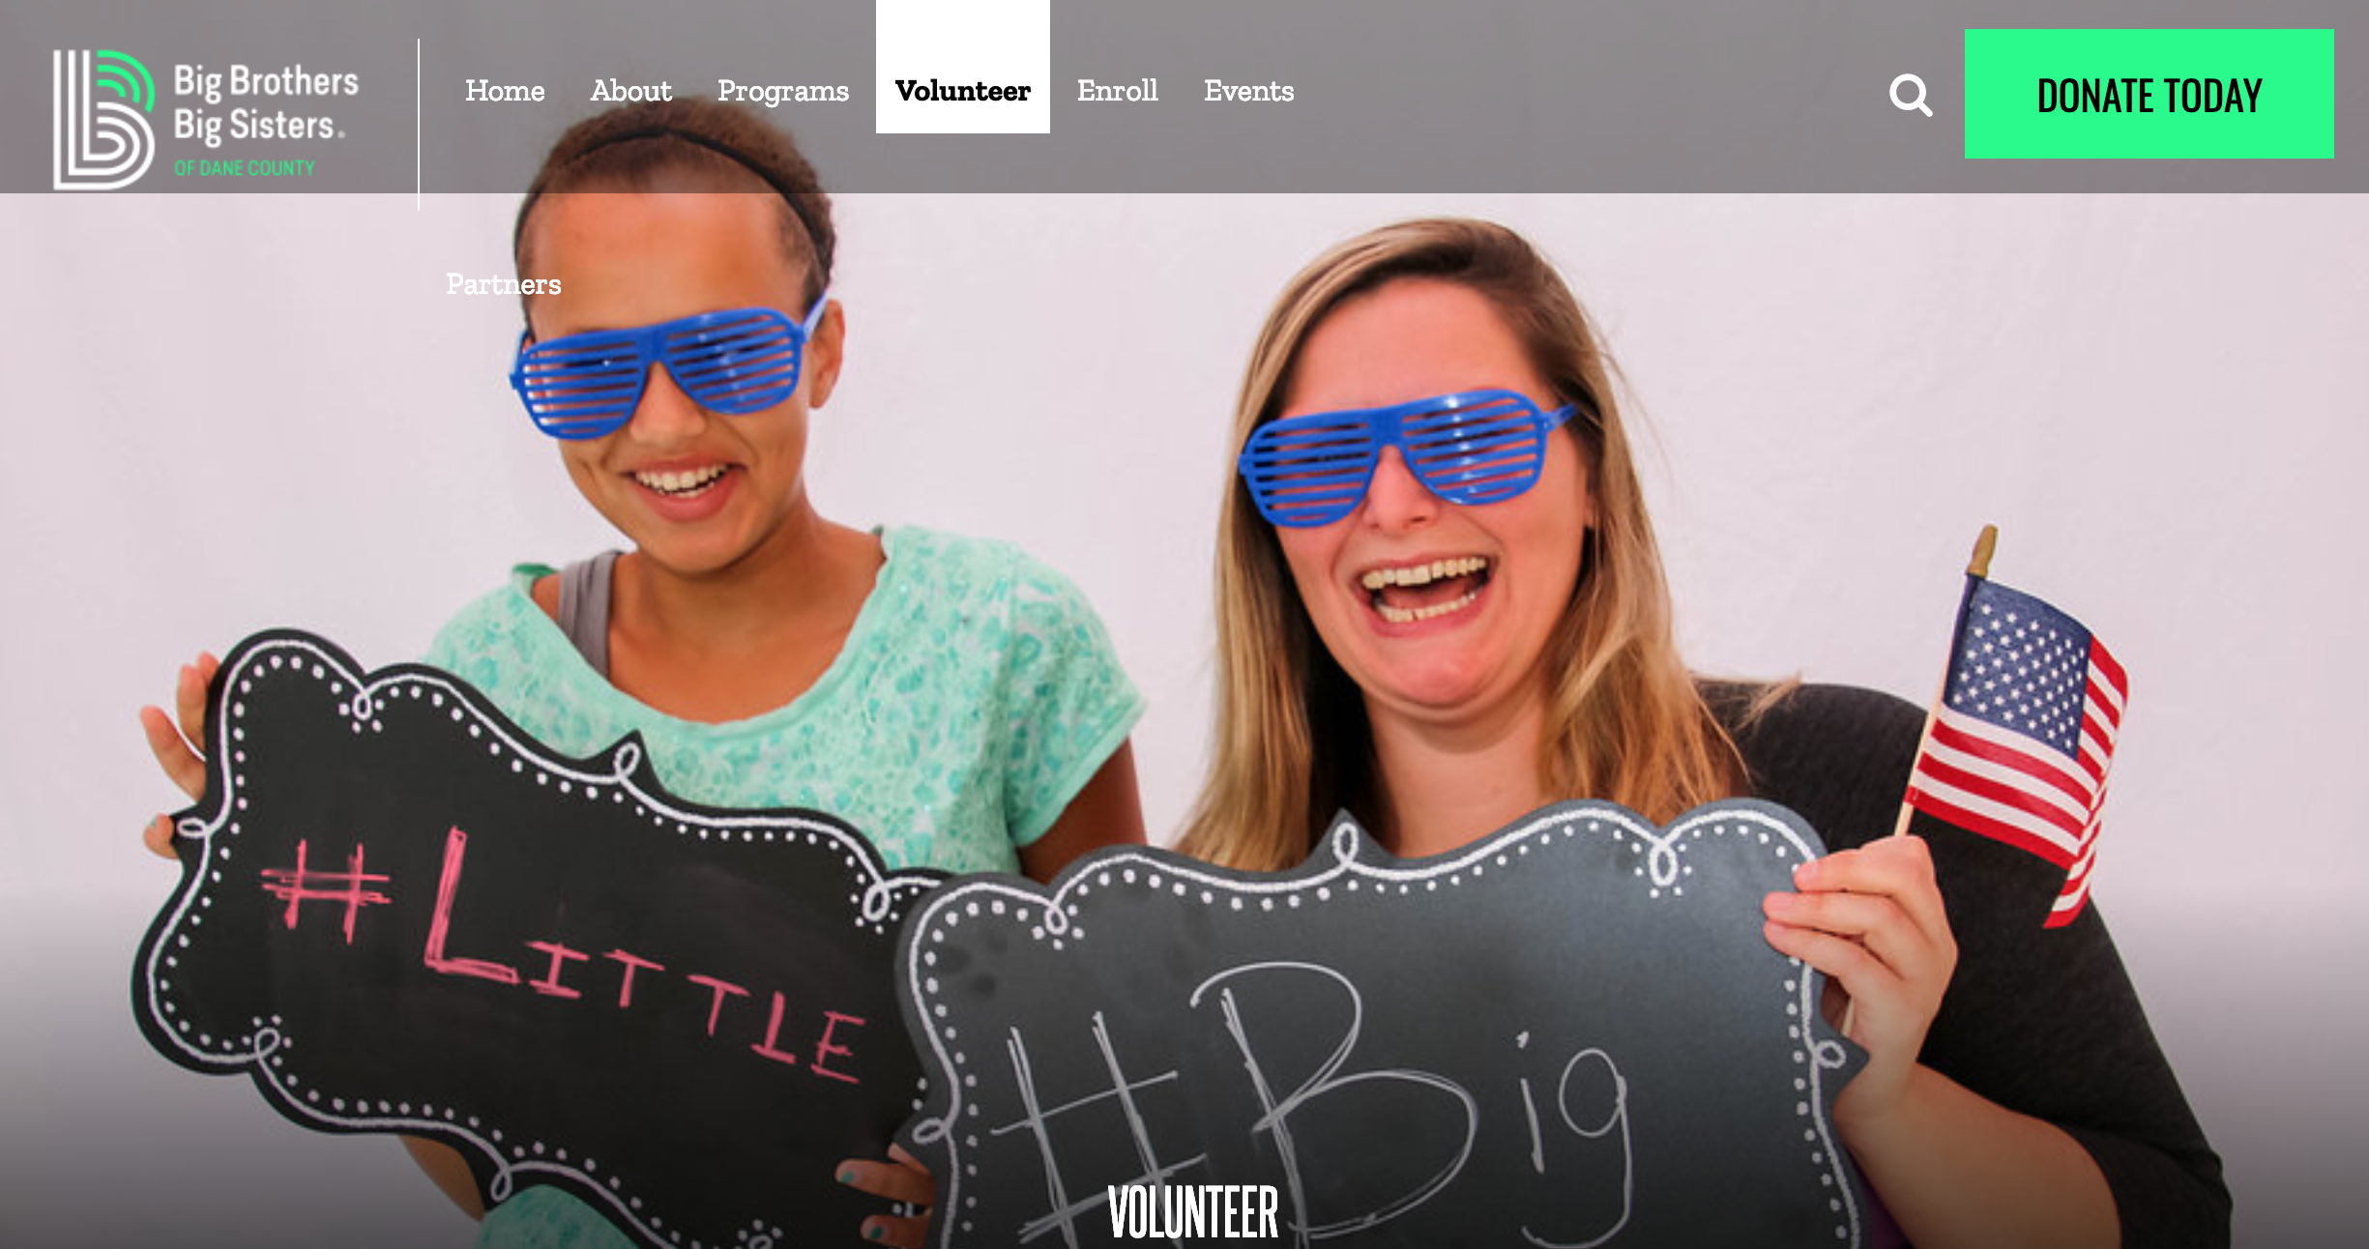
Where Did We Find These? Their Website
https://www.bbbsmadison.org

Slide 10
Example of Content Buckets: Meeting
Events (Recurring Events, Special Events, Community Events, Events for Families, Vacation Bible School)
Our Mission and Beliefs
Meet Our Leadership & Staff
Music
Weekly Message
Information for New People
Kids Ministry / Families
Youth Ministry / Teens
Adult Ministry
Worship Ministry
Outreach
Missions
Call to Action: Join Us
Call to Action: Sign Up for Newsletter
Call to Action: Give
Life Celebrations and Milestones
Inspiration
Social Fellowship Groups

Slide 11
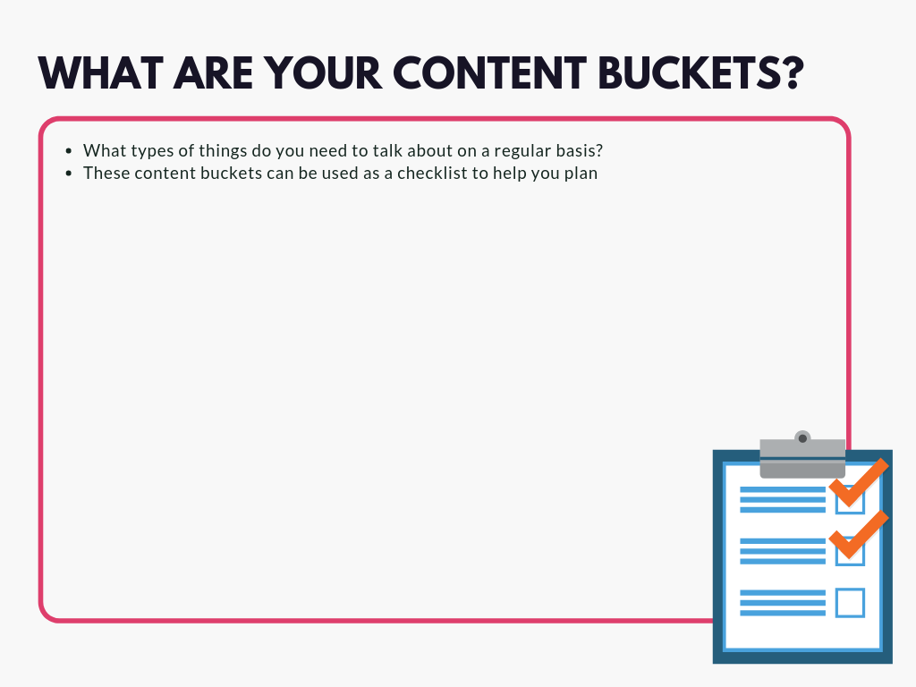

Slide 12


Slide 13
Step Two: Get Everyone Together
In other churches I’ve worked at, content planning typically includes:
  A communications committee
  OR a combination of paid staff (minister) and volunteers

Slide 14
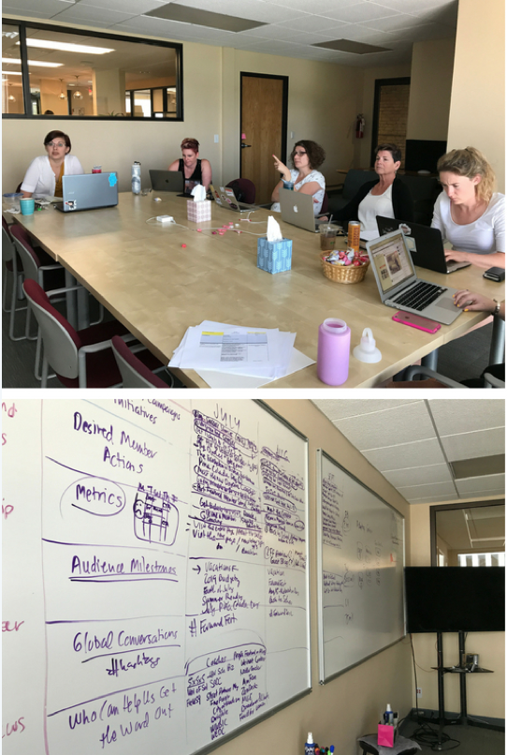
What Does It Look Like?
Gathering in a meeting room or social hall with a whiteboard, chalkboard, or paper taped to the wall
You can do this activity once a quarter (every three months) in about an hour
Or you can do this activity once a month in about 30 minutes a month

Slide 15

Two Rules for Success
Plan TOPICS, not social media content.
This keeps the meeting short, and keeps you from getting bogged down in the details of what type of social media post you’re going to do.
Brainstorm, then edit.
It’s easy to erase something or cross-something out if you don’t have time, but hard if you “step on other people’s lightbulbs.”

Slide 16


Slide 17
Six Key Questions: Plan Topics for a Month
What’s coming up this month? Are there topics related to our content buckets list we can talk about this month?
What do we want people to do as a result of seeing our social media posts this month?
What evidence or metrics tells us if they took that action?
What’s going on in our audience’s life this month?
What broader conversations are happening outside of our meeting?
Who can help us get the word out this month?

Slide 18
1. What’s Coming Up This Month?
Are There Topics Related to Our Content Buckets We Can Talk About?
Content Buckets
Events
Families
Meet Our Staff and Leadership
Calls to Action: Sign Up for Our Newsletter
Information for New People
Youth Ministry
Missions
Weekly Message
Topics
Join Us for Weekly Worship
Sign Up for Fall Sunday School Classes
Meet Our Youth Minister
Sign Up for Our Newsletter
What Are Our Services? Like?
Car Wash Fundraiser
Story about recent Mission work
Listen To Our Weekly Message

Slide 19
2. What Do We Want People to Do
Join Us For Weekly Worship
Sign Up for Sunday School
Sign Up for Our Newsletter
Listen to Weekly Message

Slide 20
3. How Do We Know If They Did That?
Worship Attendance
Visits to Sunday School Page on Website
Sunday School Registrations
Mailing List Growth
“Listens” to audio file or video views

Slide 21
4. What’s Happening in My Audience’s Life?
If you know what’s happening in your audience’s life this time of year, you can create highly relevant content that speaks to them.
  Holidays: Mother’s Day, Father’s Day
  Social Media Holidays: May the 4th – Star Wars Day
  https://media.sproutsocial.com/uploads/Sprout-Social-Hashtag-Holidays-2019.pdf
  Life Celebrations: When are students graduating? Going back to school? What are people stressing out about at this time of year? Celebrating? Is it wedding season?
  Church Calendar: Advent, Easter

Slide 22
5. Broader Conversations?
Are there hashtags people are using to talk about things that are happening outside of your organization?
Tapping into these conversations can bring your content to a broader audience
#FathersDay
#NationalSiblingsDay
#LLWS (Little League World Series)
#Oscars2019
#MusicMonday
#MadisonWI

Slide 23
6. Who Can Help Us Get the Word Out This Month?
Are you working with any partner organizations this month?
Are you volunteering at any organizations?
Did your meeting appear in the media recently?
Are there other meetings that you’re working with this month?
Tag those partners in your social media posts to help get that content in front of their audiences, too!
Examples:
  American Red Cross blood drive
  Friends Church of North Carolina event
  Name of Meeting BBQ
  To benefit Community Soup Kitchen

Slide 24
Sample Plan for a Month
Events and Content Buckets:
  Call to Action: Join Us for Weekly Worship
  Families: Sign Up for Fall Sunday School Classes
  Meet Our Youth Minister
  Listen to Our Latest Message
  Sign Up for Our Newsletter
  For New People: What Are Our Services Like?
  Youth Group
  Recent Mission Work
What Do We Want People To Do?
  Join Us
  Sign Up for Our Newsletter
  Sign Up for Sunday School
What Evidence Do We Have?
  Attendance
  Increase in Email List
  Visits to Sunday School Page on Website
What’s Happening This Month?
  Summer Vacation
  Back to School Preparation
What Broader Conversations Are Happening?
  #BackToSchool
Who Can Help Us Get the Word Out This Month?
  Org we partnered with on Mission Trip

Slide 25
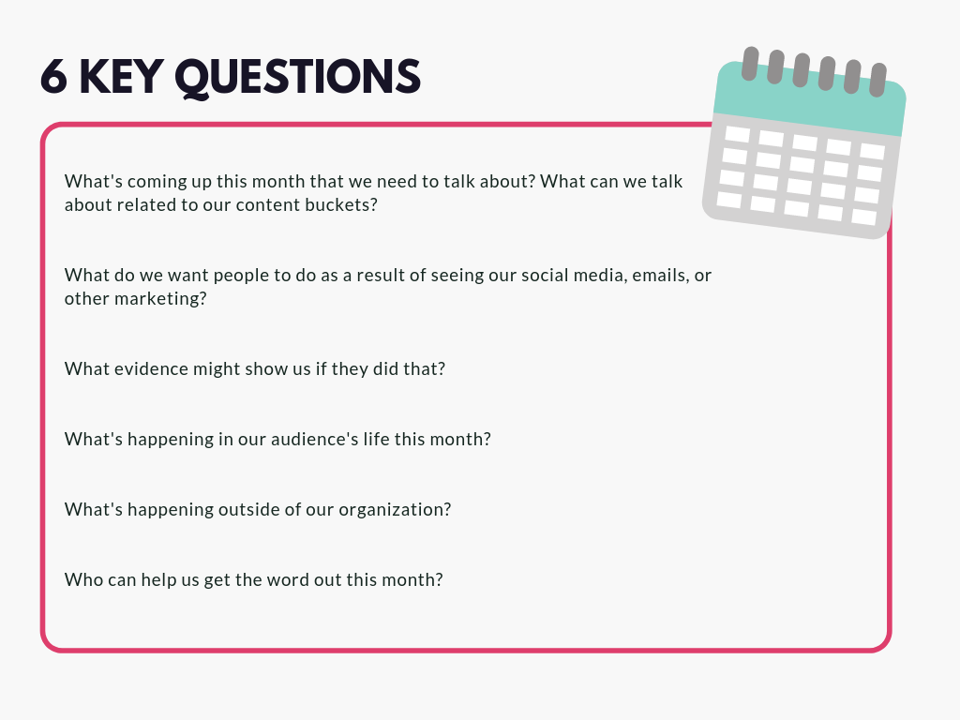
Six Key Questions Worksheet

Slide 26


Slide 27
Step Four: Plan Topics for a Month
Take your topics and put them on a calendar
Avoid Sundays and Mondays
It can take up to 24 hours for people to see a post so don’t post about an event the same day, post a couple of days ahead of time
Put in any time-specific events first, then fill in the rest with content bucket ideas

Slide 28
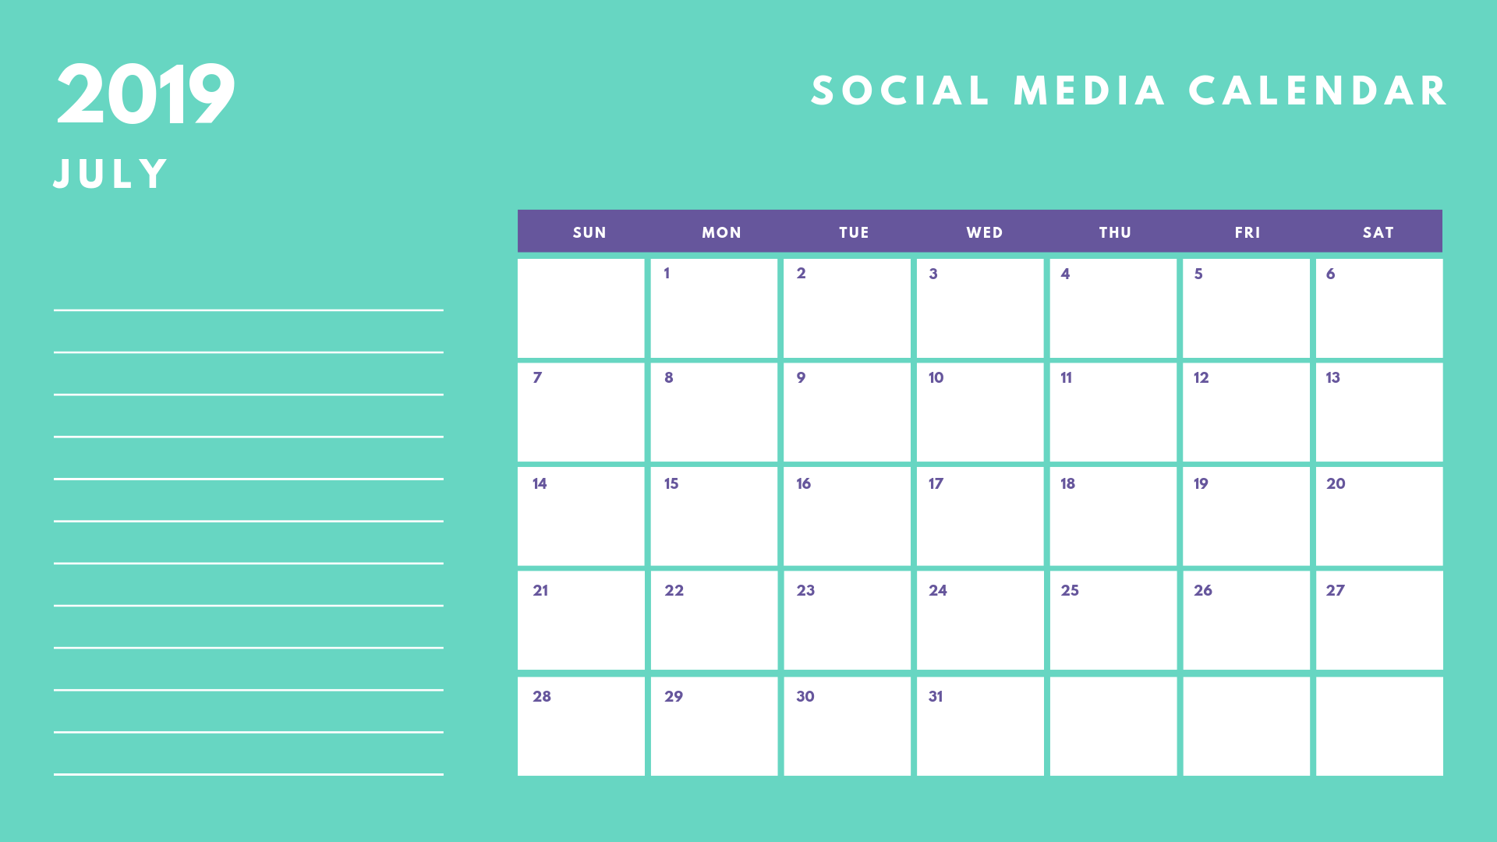
Join us for weekly worship
Happy Fourth of July
Sign Up for Fall Sunday School
Meet Our Youth Minister
Listen To Our Latest Message
Meet Our Youth Minister
Sign Up for Fall Sunday School
Sign Up for Our Newsletter
Info For New People
Youth Car Wash Reminder
Join Us for Weekly Worship
Youth Group Car Wash
Photos from Recent Mission
Youth Car Wash Happens Today
Info For New People
Listen to Our Message
Photos from Recent Mission

Slide 29
Why Take the Time to Do This?
Takes the mystery out what to post and when to post it
You can leave certain slots on your calendar EVERY month, e.g. maybe the second Tuesday of the month is always focused on Youth Ministry
The more you plan out things that are fairly predictable the better you can respond to things that arise, such as new events
And the more you’ll remember to ask people to do the things you want them to do!
You can look back next year and see what you did

Slide 30
Step Five: Delegate
You might be the only person writing social media content, but you may also be working with a group
If so, you can write everything in one sitting
If you’re working with a group divide the topics up among your group or delegate to a relevant person (e.g. Sunday School Coordinator for Sunday School information, Youth Minister for Youth information)

Slide 31
Step Six: Evaluate (Optional)
Did people do the things that you wanted them to do? Why or why not?
What posts were more or less popular? Why?
  Example: Mission post was popular because it had good photos and was shared by four people and our partner organization

Slide 32
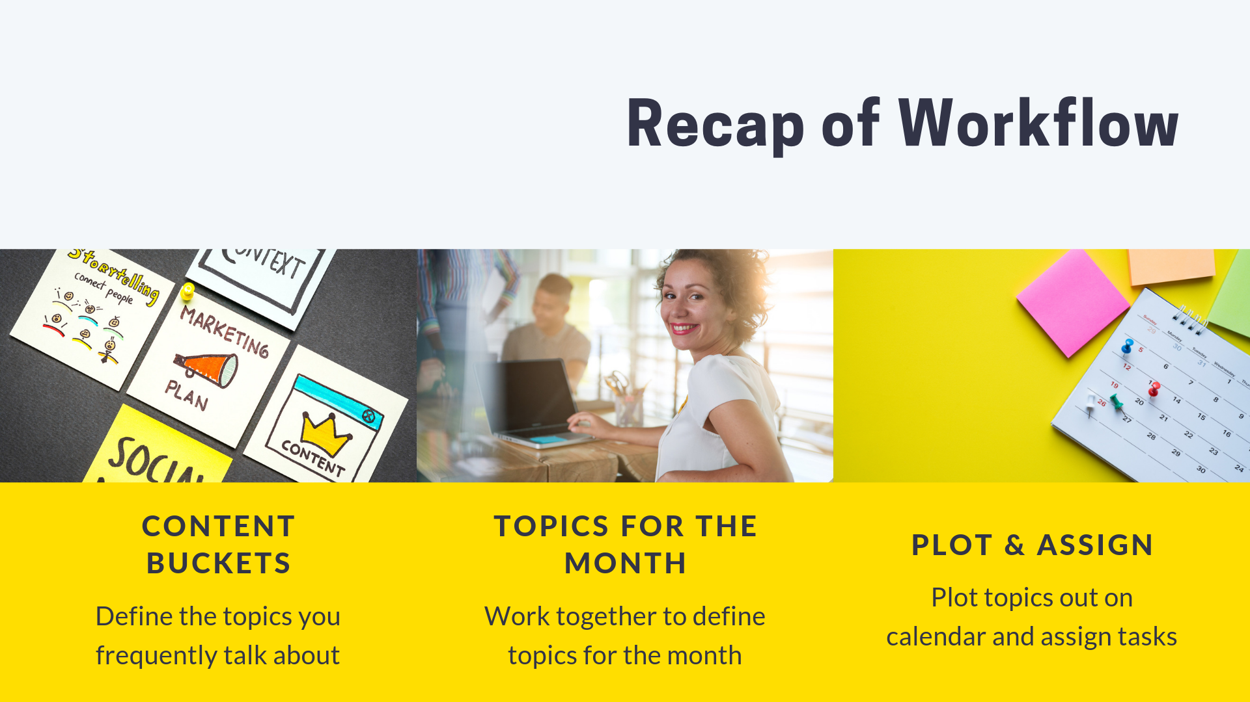

Slide 33


Slide 34
Adapting Content Across Channels
Adapting content across communications channels can:
  Help you communicate to diverse audiences
  Your seniors, youth, etc.
Save you time
  Plan and write once, then adapt
Improve brand awareness
  People need to see things more than once to remember

Slide 35
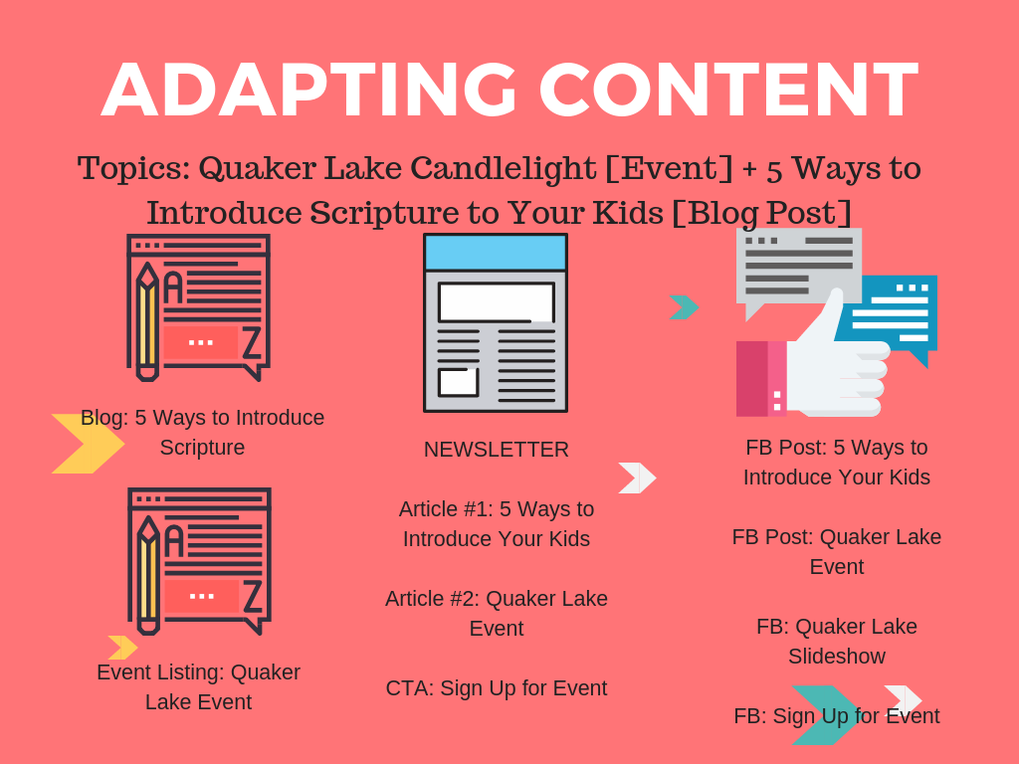

Slide 36
Adapting Content Across Channels
Website Copy
Facebook Post
Text Message
Email Newsletter
Bulletin Announcement
PPT Slide for Pastor’s Multimedia Presentation
Press Release

Slide 37
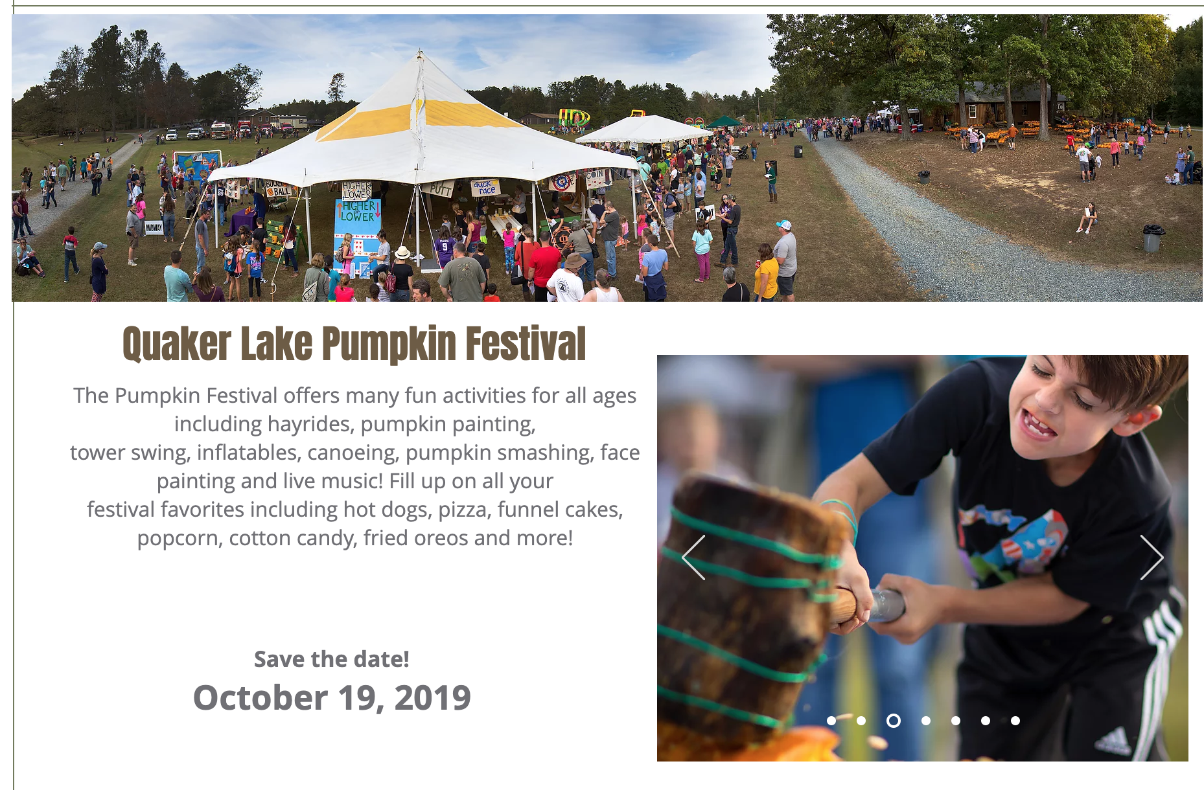
Website Copy

Slide 38
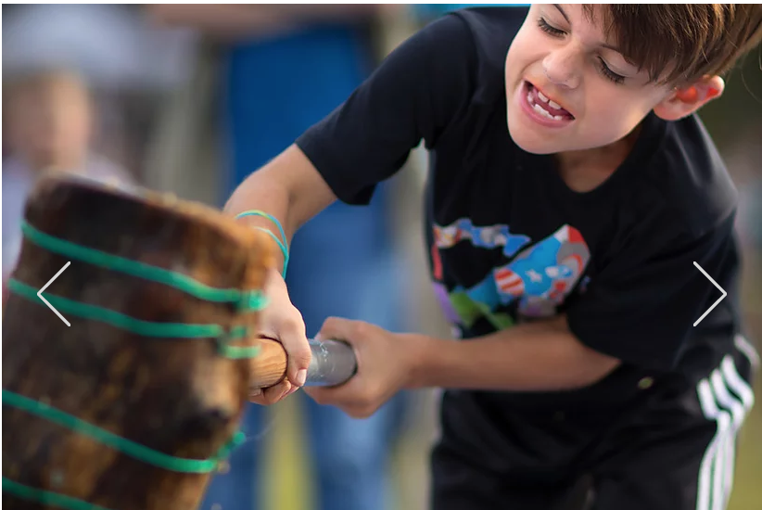
Facebook Post
SAVE THE DATE: Join us at Quaker Lake on October 19, 2019 for Pumpkin Festival, featuring fun for all ages, Including hayrides, pumpkin painting and smashing, and more! Learn more: http://bit.ly/xxxxxx

Slide 39
Text Message
Join us on 10/19 for Pumpkin Fest at Quaker Lake. Fun for all ages – pumpkin painting & more. Info at quakerlakecamp.org See you there! 🎃

Slide 40
Bulletin Announcement
**************************************************
SAVE THE DATE! QUAKER LAKE PUMPKIN FESTIVAL
Families with children of all ages can JOIN US from 12pm-5pm on October 19, 2019 for Quaker Lake’s annual Pumpkin Festival. Featuring fun for all ages, Including hayrides, pumpkin painting and smashing, and more! For more information email xxxx@gmail.com or visit quakerlakecamp.org
**************************************************

Slide 41
Example: Phone Tree Talking Points
Hi [FIRST NAME]!
I wanted to make sure that you heard about Quaker Lake’s Annual Pumpkin Fest
It has activities for kids of all ages – hayrides, pumpkin paintings – it’s a lot of fun
It’s happening on October 19
See you there?

Slide 42


Slide 43
What is Evergreen Content?
Evergreen content is content that never goes out of date
We encourage you to create a library of evergreen content that you can use again and again
Some examples of evergreen content are:
  Sign up for our newsletter
  Website information: Our Beliefs
  Pumpkin Fest – can update and adapt each year
Evergreen content saves you time because you can reuse it!

Slide 44
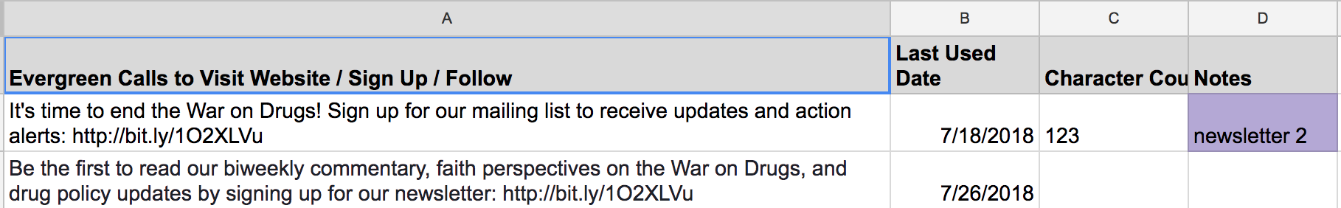

Slide 45
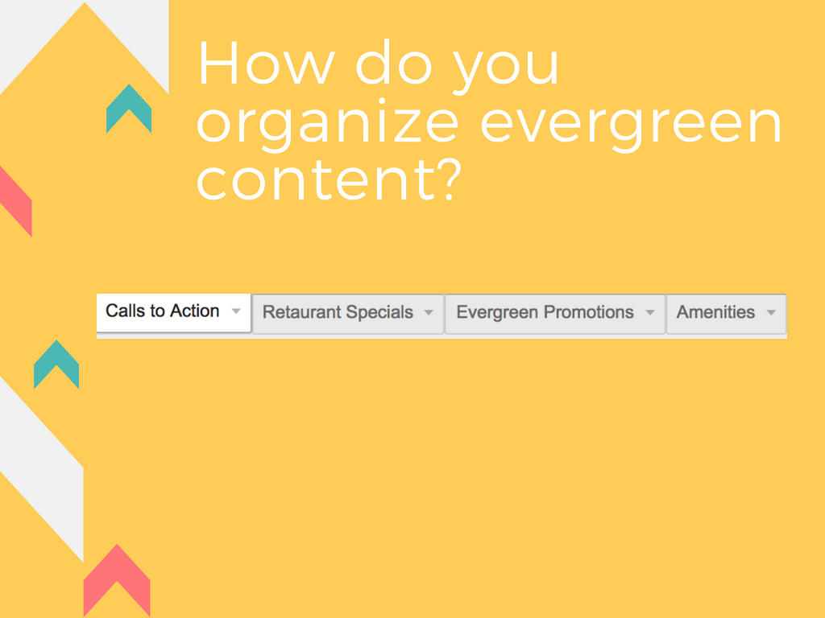
How do you organize evergreen content?

Slide 46
Evergreen Content: Where Can You Find It?
On your website
In brochures you’ve already written
Last year’s social media content

Slide 47
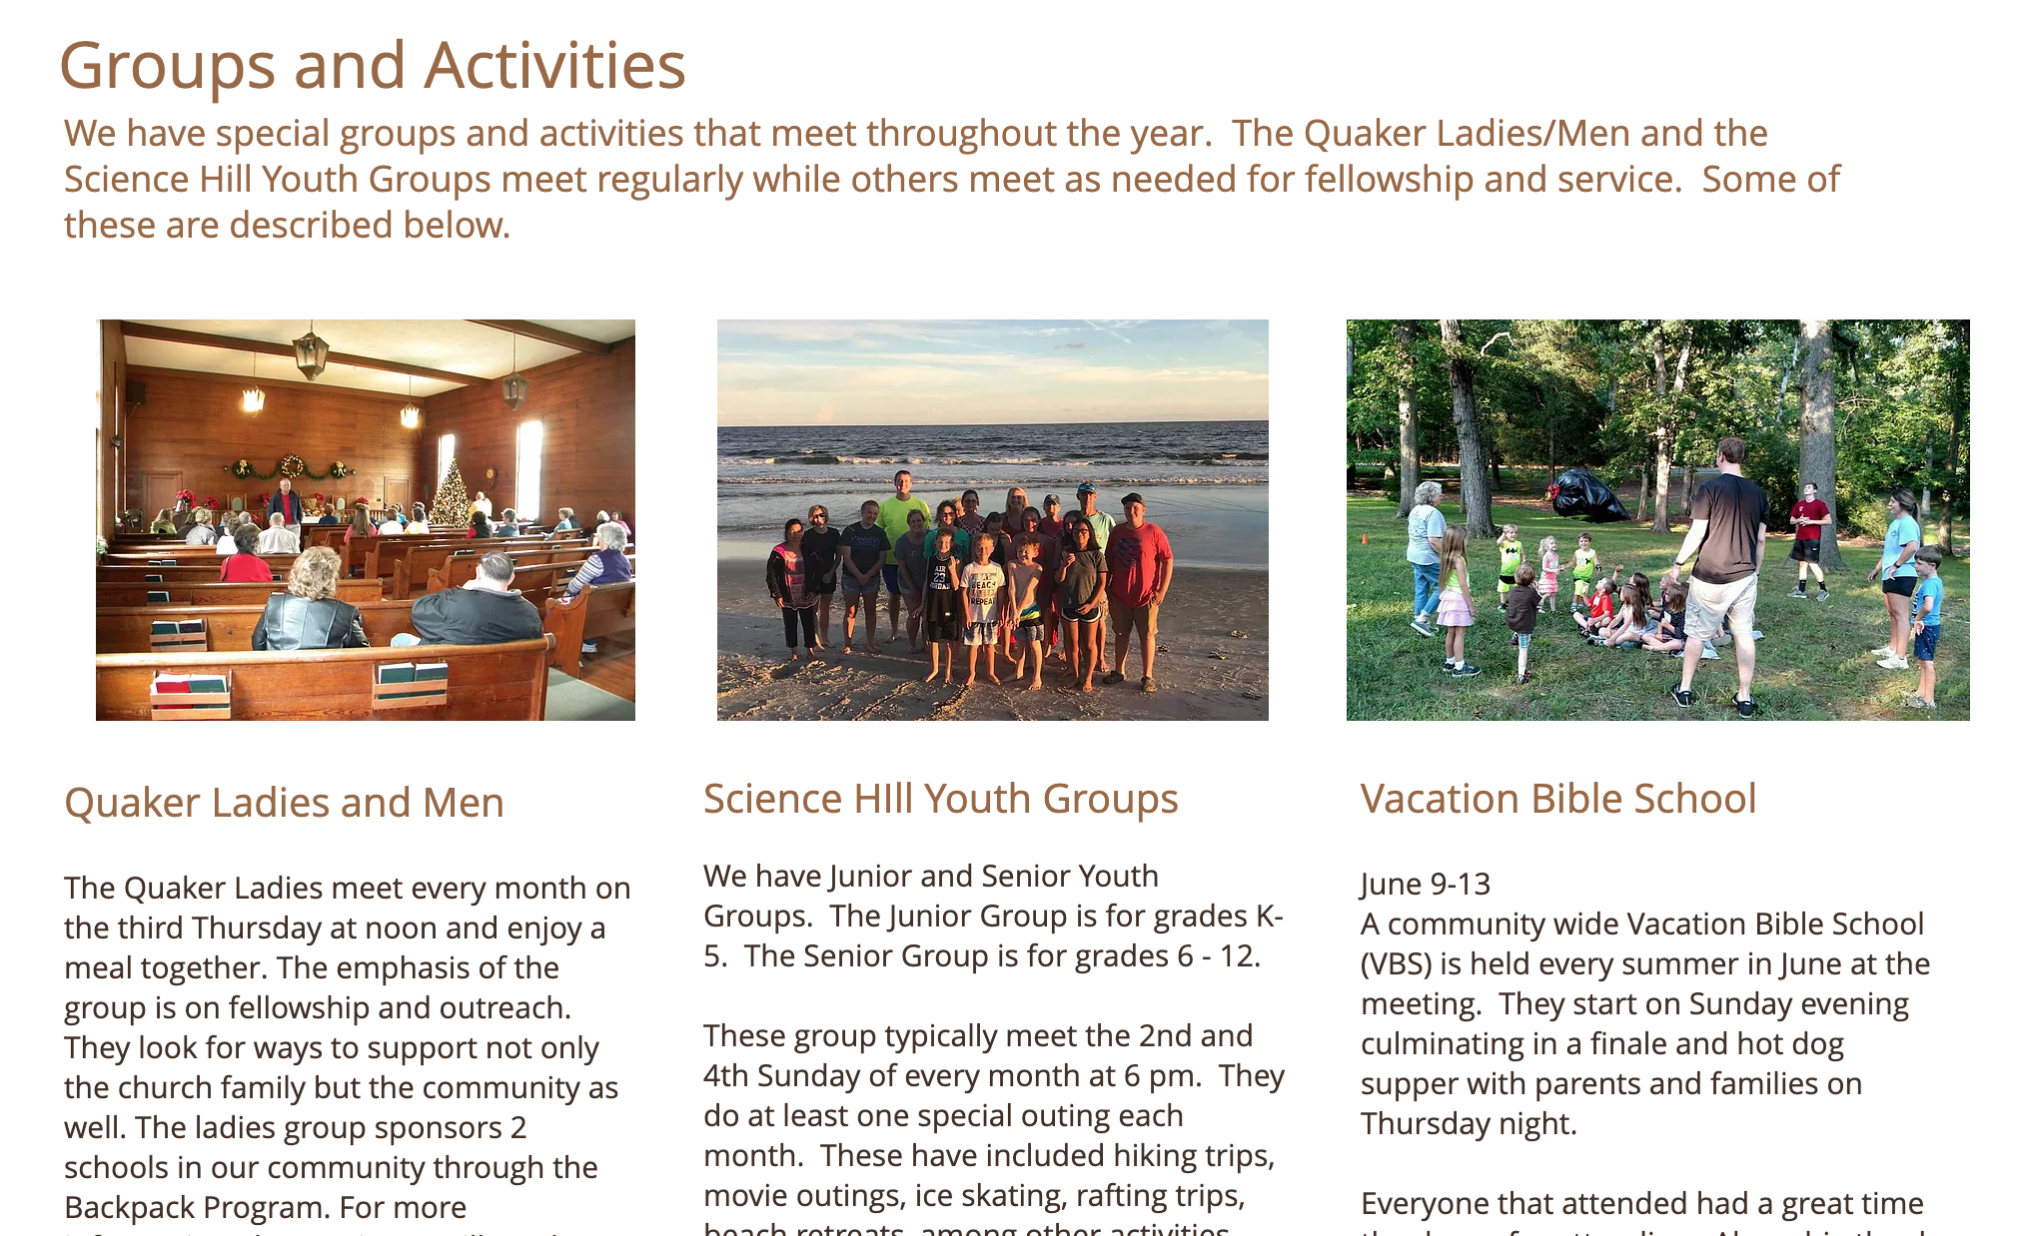
Example: Science Hill Meeting

Slide 48
Example Social Media Posts
The Quaker Ladies meet every month on the third Thursday at noon and enjoy a meal together. The emphasis of the group is on fellowship and outreach. Learn more on our Groups and Activities page:
The Quaker Men meet the first Sunday of each month at 8:30a.m for fellowship. Learn more on our Groups and Activities Page:
Science HIll has two youth groups, a Junior Group is for grades K- 5, and a Senior Group for grades 6 - 12. Youth meet every other Sunday, and do a special outing each month such as hiking trips, ice skating, rafting trips, and more. Join in the fun! Learn more on our Groups and Activities Page:
Join us for Vacation Bible School, June 9-13! Open to our whole community, Vacation Bible School (VBS) is held every summer in June. Sign up:
Join us for a Vacation Bible School finale and hot dog supper with parents and families on Thursday night June 13! Learn more on our Groups and Activities Page:

Slide 49
